Slide 1
Electromagnetics
Farhad Mazlumi
Assistant Professor
Civil Aviation Technology College, Tehran

Slide 2
Vector Calculus

Slide 3
Quantity
A physical quantity (or simply quantity) is a property of a material or system that can be quantified by measurement.
A physical quantity can be expressed as a value, which is the algebraic multiplication of a numerical value and a unit of measurement.
Quantities in electromagnetics can be functions of time and position.

Slide 4
Field
A field is a spatial distribution of a quantity, which may or may not be a function of time.

Slide 5
Categories of Quantities
Scalar
  At a given time and position, a scalar is completely specified by its magnitude (positive or negative, together with its unit).
  Example: electric charge
Vector
  At a given time and position, a vector requires both a magnitude and a direction.
  Example: Electric field intensity
E

Slide 6
Tensor
A tensor is a mathematical object that provides a coordinate-independent description of a physical property.
It is a Geometric Object:
  This means a tensor represents a well-defined entity that exists in space, independent of how we choose to describe it. Think of it as a physical “thing” (like electric field intensity, or the permittivity of an anisotropic medium) rather than a mere list of numbers.
It is Coordinate-Independent:
  The physical reality the tensor represents does not change when we change our coordinate system (e.g., rotating our x, y, z axes). However, its components—the specific set of numbers we write in a matrix to represent it—do change in a very precise and compensatory way.

Slide 7
Tensor Ranks
The rank of a tensor indicates the number of indices needed to describe it in a given coordinate system. It classifies physical quantities by their geometric complexity.
Rank | Common Name | Example in Electromagnetics | Description
0 | Scalar | Electric charge (Q), Potential (V), Energy (W) | A single, coordinate-independent number.
1 | Vector | Electric field intensity (E), Magnetic flux density (B), Current density (J) | Describes magnitude and direction. Requires 3 components (in 3D) that transform together under rotation.
2 | Tensor (Dyadic) | Permittivity tensor (ϵ_{ij}​), Permeability tensor (μ_{ij}​) | Relates two vectors. Requires 9 components (in 3D) that transform in a specific way. Describes anisotropy or complex relationships.

Slide 8
Vector vs. Set of Three Numbers
A set of three numbers is a vector (rank-1 tensor) only if the numbers represent components along directions in a geometric space that transform together under coordinate changes.
(3 apples, 2 oranges, 5 peaches) is not a vector. This is just a tuple of scalars. Each item (apple count, orange count, peach count) is a scalar: a coordinate-independent number.
(E_{x​} = 3 V/m, E_{y}​ = 2 V/m, E_{z}​ = 5 V/m) is a vector. The components of a vector are not independent numbers; they mix (transform) in a specific way under coordinate rotation, as seen with electric field components.

Slide 9
Magnitude and Unit Vector
Magnitude of vector A: |A| or A
A
Note: A has the unit and dimension of A.
|A|
A
Unit vector of A:
Note: unit vector is dimensionless.

Slide 10
Vector Addition and Subtraction
A
B
A+B
A-B = A+(-B)
B
-B
A
A+B
A-B
A

Slide 11
Products of a Vector and a Scalar
Multiplication of a vector (A) by a positive scalar (a > 0)
Multiplication of a vector (A) by a negative scalar (a < 0)
A
aA
A
aA

Slide 12
Dot Product
Applications:
  Magnitude of a vector
  Vector projection
B
γ
A
B
γ
b
A

Slide 13
Properties of Dot Product
Commutative law
Distributive law

Slide 14
Cross Product
Applications:
  Area of parallelogram
  Normal vector
B
γ
A
B
γ
S
A
B
A

Slide 15
Properties of Cross Product
NOT commutative
Distributive law
NOT associative

Slide 16
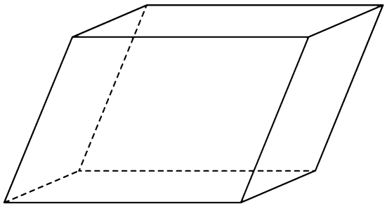
Properties of Three Vectors
Volume of the parallelepiped formed by the three vectors A, B, and C
A
C
B

Slide 17
Orthogonal Coordinate Systems
Mathematical representation of
  the location of a point
  a vector
A
P
Point
Vector

Slide 18
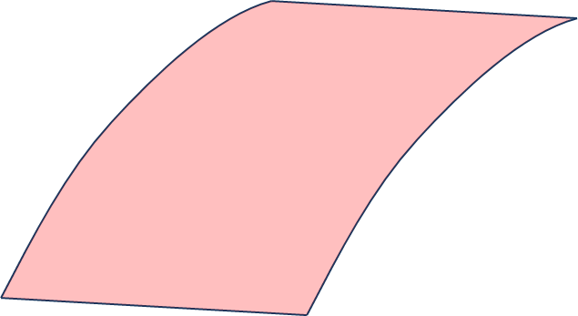
Coordinates of a point
Three-dimensional space → (u₁, u₂, u₃)
u₂ = 12
u₂ = 12
u₃ = 15
u₁ = 10
u₁ = 10
u₁ = 10

Slide 19
Base Vectors
Unit vectors
u₂ = 12
u₂ = 12
u₃ = 15
u₃ = 15
u₁ = 10

Slide 20
Base Vectors
Right-handed Orthogonal Coordinate System

Slide 21
Vector Representation
A

Slide 22
Addition, Subtraction, and Products

Slide 23
Dot Product of Two Vectors
C
A
γ
B
1
Vector Subtraction
2
Law of Cosines
1
2

Slide 24
Differential Length
C
Some of the coordinates may not be a length.
Metric coefficients: h₁, h₂ and h₃
dl

Slide 25
Differential Area
u₁ = 10

Slide 26
Differential Volume

Slide 27
Orthogonal Coordinates Systems
Cartesian coordinates
Cylindrical polar coordinates
Spherical coordinates
Parabolic coordinates
Paraboloidal coordinates
Ellipsoidal coordinates
Bipolar cylindrical coordinates
Reference: https://en.wikipedia.org/wiki/Orthogonal_coordinates

Slide 28
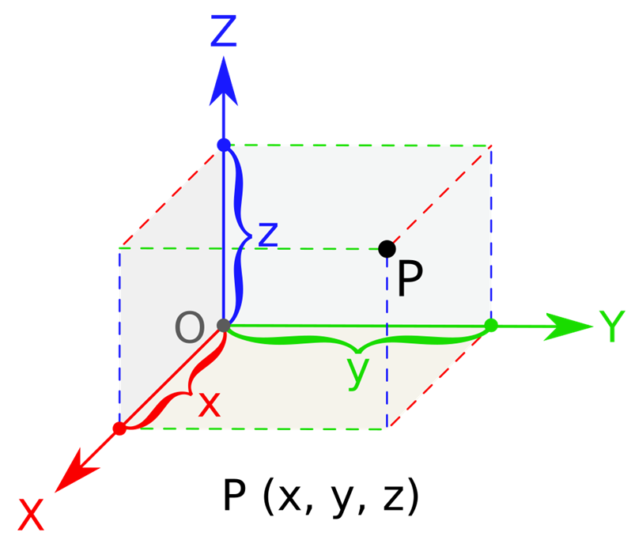
Cartesian Coordinate System
(u₁, u₂, u₃) = (x, y, z)
h₁ = 1, h₂ = 1, h₃ = 1

Slide 29
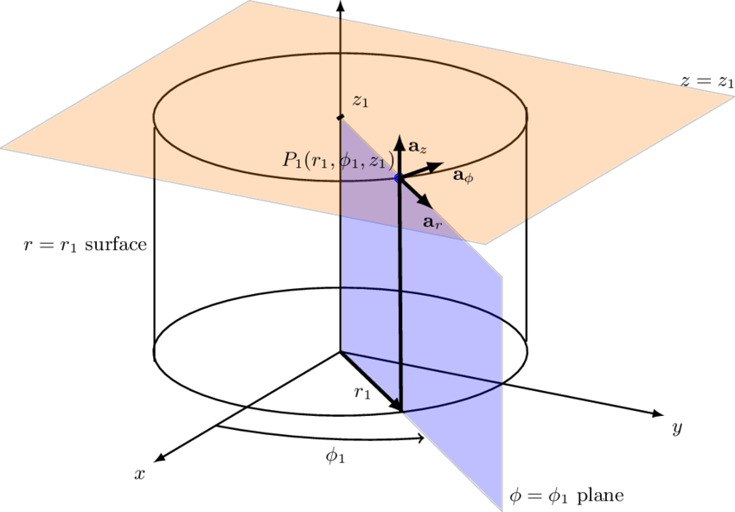
Cylindrical Coordinate System
(u₁, u₂, u₃) = (r, ϕ, z)
r ≥ 0
0 ≤ ϕ < 2π

Slide 30
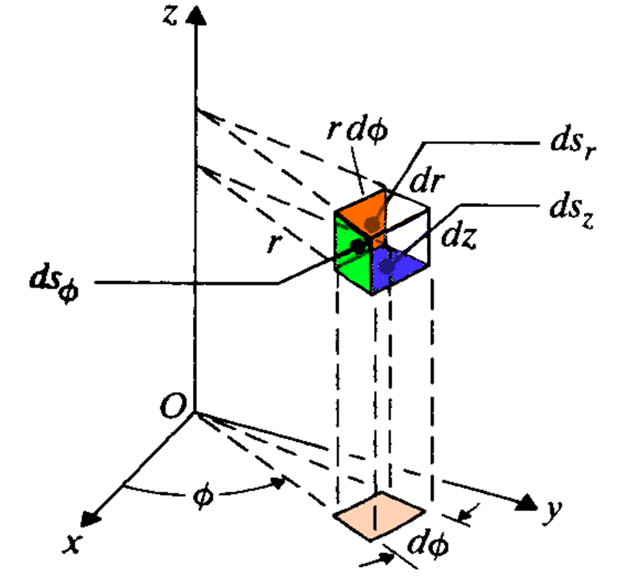
Cylindrical Coordinate System
h₁ = 1, h₂ = r, h₃ = 1

Slide 31
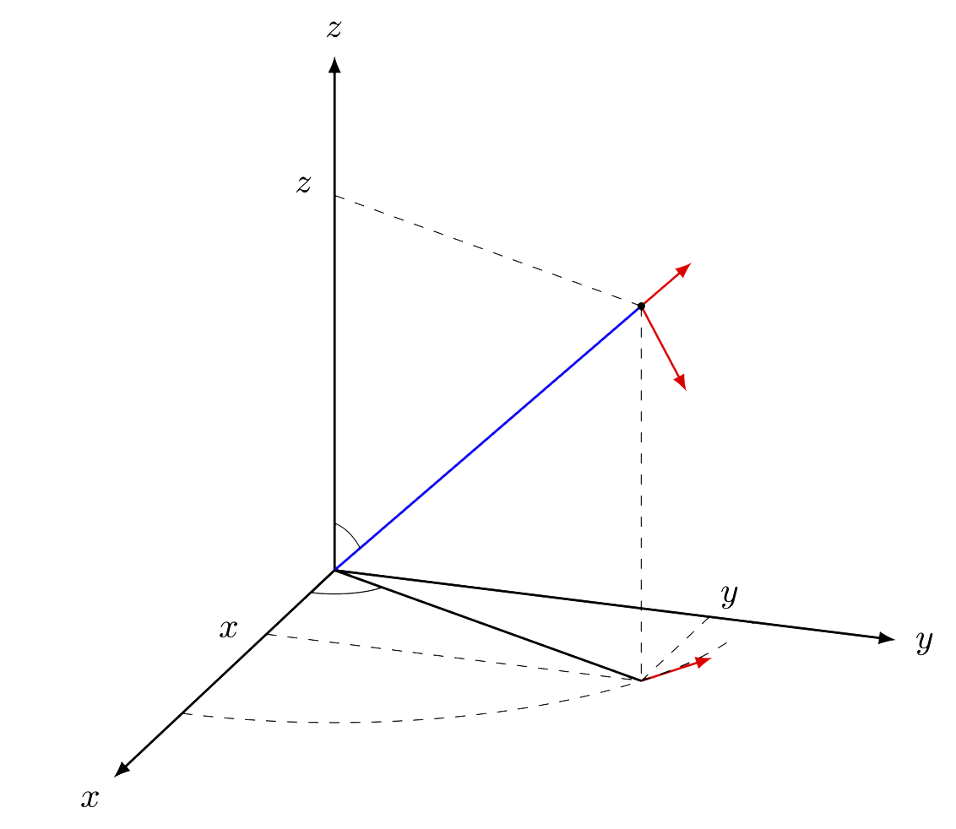
Spherical Coordinate System
(u₁, u₂, u₃) = (R, θ, ϕ)
0 ≤ ϕ < 2π
0 ≤ θ ≤ π

Slide 32
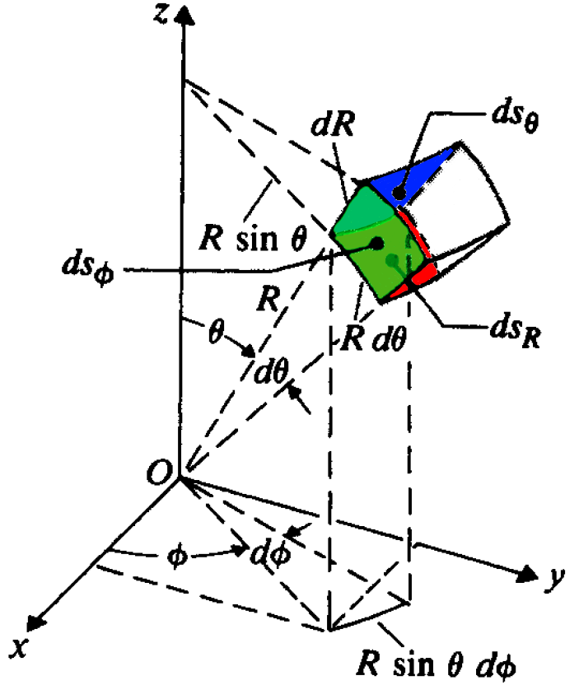
Spherical Coordinate System
h₁ = 1, h₂ = R, h₃ = Rsinθ = r

Slide 33
Exercise: Sum of Two Vectors
33

Slide 34
Exercise: Dot Product of Two Vectors
34

Slide 35

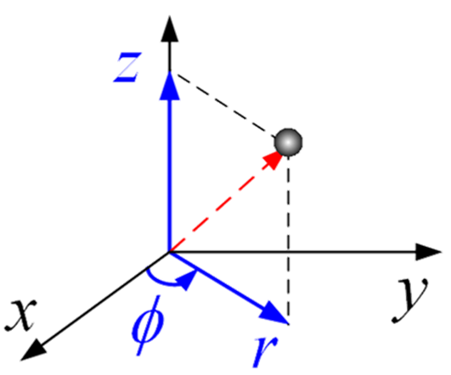
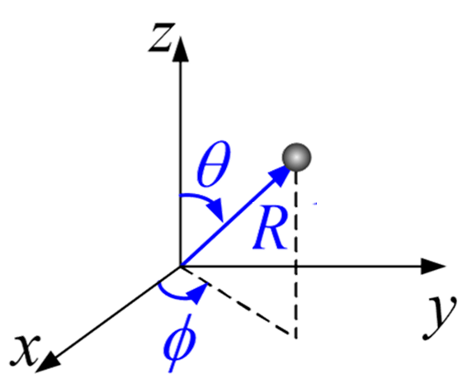
Unit Vectors on z-axis
35

Slide 36
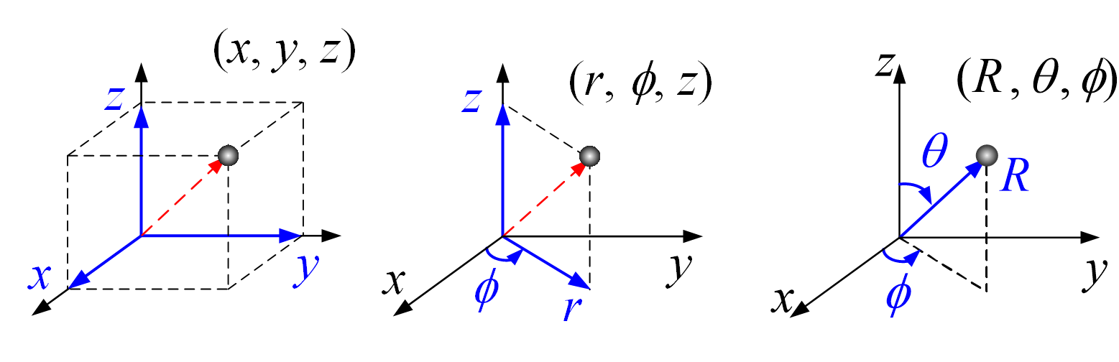
Position Vector
A position vector is a vector that represents the location of a point in space relative to a fixed origin, typically expressed in terms of its coordinates.
R
R
R

Slide 37
From Cylindrical to Cartesian Coordinates
Point coordinates

Slide 38
From Cartesian to Cylindrical Coordinates
Point coordinates
?

Slide 39
From Cylindrical to Cartesian Coordinates
Vector expression

Slide 40
From Cylindrical to Cartesian Coordinates (cont.)
Vector expression

Slide 41
From Cartesian to Cylindrical Coordinates
Vector expression

Slide 42
From Spherical to Cartesian Coordinates
Point coordinates

Slide 43
From Cartesian to Spherical Coordinates
Point coordinates
?

Slide 44

From Spherical to Cartesian Coordinates
Vector expression

Slide 45
From Spherical to Cartesian Coordinates (cont.)
Vector expression

Slide 46
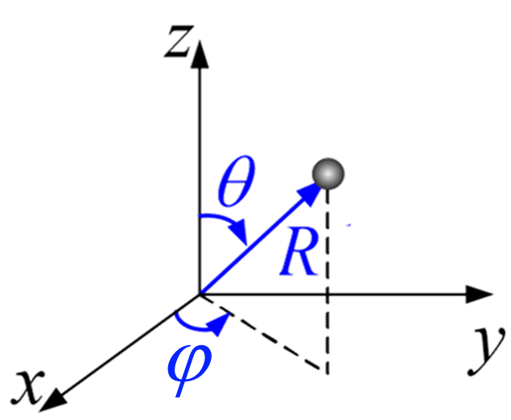
From Cartesian to Spherical Coordinates
Vector expression

Slide 47
Integrals Containing Vector Functions
Volume Integral of a Vector Function
Line Integral (Path Integral) of a Vector Function
Surface Integral of a Vector Function

Slide 48
Vector Function
Vector function (or vector field): a spatial distribution of a vector quantity

Slide 49
Vector Function (examples)

Slide 50
Volume Integral of a Vector Function

Slide 51
Parametric Representation of Paths
Path: a one-dimensional curve in space.
It can be mathematically described using a single independent parameter (usually denoted as t).
z
t₁
C
t
t₂
R(t)
y
x

Slide 52
Differential Path Element
t
t+Δt
ΔR
R(t)
R(t+Δt)
O

Slide 53
Differential Path Element (cont.)

Slide 54
Differential Path Element (cont.)
F(t)
t
dl(t)
C
t₁
t₂

Slide 55
Line Integral of a Vector Function

Slide 56
Line Integral of a Vector Function (example)

Slide 57
Line Integral of a Vector Function (example)

Slide 58
Parametric Representation of Surfaces
Surface: a two-dimensional object in space.
It needs two independent parameters (usually denoted as u and v).
S
(u,v)
z
R(u,v)
y
x

Slide 59
Differential Surface Element
S
(u,v+Δv)
Δs
(u,v)
(u+Δu,v)
R
O

Slide 60
Surface Integral of a Vector Function
S
F
(u,v)
ds
R
O

Slide 61
Parametric Representation of Surfaces (example)
Notes:
Plot the surface

Slide 62
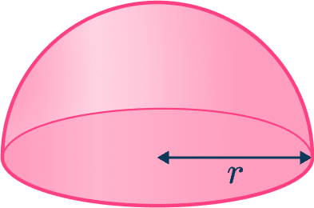
Parametric Representation of Surfaces (exercise)
z
z
y
y
0
x
x

Slide 63
Vector Differential Operators
Three primary operations that are essential for describing electromagnetic fields:
  Gradient
  Divergence
  Curl
Each one has a distinct physical interpretation.
These operators are defined using the del symbol (∇).

Slide 64
Gradient of a Scalar Field
Input: a scalar field, e.g. f(R) Output: a vector field, e.g. F(R)
Gradient symbol
Vector field
Scalar field

Slide 65
Gradient of a Scalar Field (cont.)
Gradient magnitude: Rate of maximum increase
Gradient direction: Steepest ascent
Gradient direction
Gradient symbol
Gradient magnitude
Vector field
Scalar field

Slide 66
Gradient of a Scalar Field (example)
Magnitude → Rate of maximum increase
Direction → Steepest ascent
f = 6.2
f = 6.1
P: (x = 9, y = 2, z = 3)
Gradient direction
f = 6
f(x = 9, y = 2, z = 3) = 6
f = 6.1
Δl
Δl = 0.1
P
f = 5.9
f = 6
f = 5.9
f = 5.8

Slide 67

Gradient and Equipotential Surfaces
A scalar field f(x, y, z) assigns a number to every point in space.
A level surface (or equipotential surface) is the locus of all points satisfying:
f(x, y, z) = constant
At any point P, the gradient vector of a scalar field is perpendicular (normal) to the equipotential surface that passes through P.
f = 1.6
f = 1.5
f = 1.4
∇f
P: (x₀, y₀, z₀)
f = f(x₀, y₀, z₀)

Slide 68
Directional Derivative
Directional derivative is the rate at which a scalar field f changes at a point P in a specific direction ( ).
∇f
Directional derivative
P
O

Slide 69
Fundamental Theorem for Gradient
The line integral of a gradient field depends only on the endpoints (P₁ and P₂), not on the path taken (C).
P₂
C
P₁

Slide 70
Fundamental Theorem for Gradient (cont.)
O

Slide 71
Gradient in Orthogonal Curvilinear Coordinates
General orthogonal curvilinear coordinate system (u₁​,u₂​,u₃​) with metric coefficients h₁, h₂, h₃

Slide 72
Gradient in Cartesian Coordinates
u₁​ = x, u₂​ = y, u₃​ = z
h₁ = 1, h₂ = 1 , h₃ = 1

Slide 73
Gradient in Cylindrical Coordinates
u₁​ = r, u₂​ = ϕ, u₃​ = z
h₁ = 1, h₂ = r , h₃ = 1

Slide 74
Gradient in Spherical Coordinates
u₁​ = R, u₂​ = θ, u₃​ = ϕ
h₁ = 1, h₂ = R, h₃ = R sinθ

Slide 75
Gradient of a Scalar Field (example)
f₁ = x
f₂ = r cosϕ
f ₃ = R sinθ cosϕ

Slide 76
Divergence of a Vector Field
Input: a vector field, e.g. F(R) Output: a scalar field, e.g. f(R)
Divergence symbol
Scalar field
Vector field

Slide 77
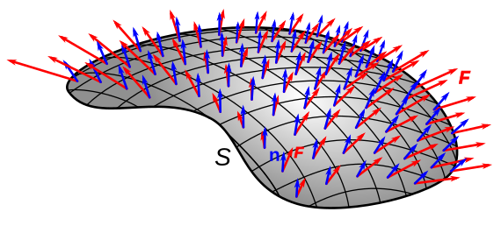
Flux of a Vector Field
Flux is the net flow of a vector field F passing through a surface S along its normal direction.
Vector field (F): red arrows
Unit normal vector ( ): blue arrows

Slide 78
Definition of Divergence
Divergence is the flux of a vector field per unit volume, as the volume shrinks to a point.
Flux out of Δv
S: the closed surface bounding the volume Δv.

Slide 79
Divergence of a Vector Field (example)
F
F
F

Slide 80
Fundamental Theorem for Divergence
Divergence theorem
V
S

Slide 81
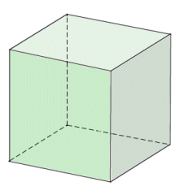
Fundamental Theorem for Divergence (cont.)
V
Δv
S

Slide 82
Divergence in Orthogonal Curvilinear Coordinates
General orthogonal curvilinear coordinate system (u₁​,u₂​,u₃​) with metric coefficients h₁, h₂, h₃

Slide 83
Divergence in Cartesian Coordinates
u₁​ = x, u₂​ = y, u₃​ = z
h₁ = 1, h₂ = 1 , h₃ = 1

Slide 84
Divergence in Cylindrical Coordinates
u₁​ = r, u₂​ = ϕ, u₃​ = z
h₁ = 1, h₂ = r , h₃ = 1

Slide 85
Divergence in Spherical Coordinates
u₁​ = R, u₂​ = θ, u₃​ = ϕ
h₁ = 1, h₂ = R, h₃ = R sinθ

Slide 86
Divergence of a Vector Field (example)

Slide 87
Curl of a Vector Field
Input: a vector field, e.g. G(R) Output: a vector field, e.g. F(R)
Curl symbol
Vector field
Vector field

Slide 88
Circulation of a Vector Field
Circulation (or rotation) of a vector field F around a closed path C is defined as the scalar line integral of the vector over the path.
C

Slide 89
Definition of Curl
The curl of a vector field F is a vector
  whose magnitude is the net circulation of F per unit area as the area tends to zero, and
  whose direction is the normal direction of the area when the area is oriented to make the net circulation maximum (right-hand rule).
Δs
C

Slide 90
Fundamental Theorem for Curl
Stokes’ theorem
ds
C
S

Slide 91
Fundamental Theorem for Curl (cont.)
C
C₁
C₂
S

Slide 92
Volume Integral of the Curl of a Vector Field
It shows that the net curl content inside a volume manifests as a tangential surface effect.
V
S

Slide 93
Volume Integral of the Curl of a Vector Field
Let C be any constant vector.
V
S

Slide 94
Curl in Orthogonal Curvilinear Coordinates
General orthogonal curvilinear coordinate system (u₁​,u₂​,u₃​) with metric coefficients h₁, h₂, h₃

Slide 95
Curl in Cartesian Coordinates
u₁​ = x, u₂​ = y, u₃​ = z
h₁ = 1, h₂ = 1 , h₃ = 1

Slide 96
Curl in Cylindrical Coordinates
u₁​ = r, u₂​ = ϕ, u₃​ = z
h₁ = 1, h₂ = r , h₃ = 1

Slide 97
Curl in Spherical Coordinates
u₁​ = R, u₂​ = θ, u₃​ = ϕ
h₁ = 1, h₂ = R, h₃ = R sinθ

Slide 98
Curl of a Vector Field (example)

Slide 99
Two Null Identities

Slide 100
Irrotational and Solenoidal Fields
A vector field F is solenoidal (or divergenceless) if its divergence is zero at every point.
A vector field F is irrotational (or conservative) if its curl is zero at every point.

Slide 101
Features of Solenoidal Fields
1)
Source free
2)

Slide 102
Features of Irrotational Fields
1)
Path independent
2)

Slide 103
Classification of Vector Fields
Solenoidal and irrotational
Solenoidal but not irrotational
Irrotational but not solenoidal
Neither solenoidal nor irrotational

Slide 104
Helmholtz’s Theorem
A vector field is determined to within an additive constant if both its divergence and its curl are specified everywhere.

Slide 105
Helmholtz’s Theorem (cont.)
A general vector field F can be written as

