Slide 1
Electromagnetics
Farhad Mazlumi
Assistant Professor
Civil Aviation Technology College, Tehran

Slide 2
Steady Electric Currents

Slide 3
Types of Electric Currents
There are several types of electric currents caused by the motion of free charges:
Conduction currents in conductors and semiconductors are caused by drift motion of conduction electrons and/or holes.
Electrolytic currents are the result of migration of positive and negative ions.
Convection currents result from motion of electrons and/or ions in a vacuum.

Slide 4
Conduction Current
Atoms in metals form a crystal lattice. Electrons in the outermost (valence) shells are loosely bound and free to move randomly.
With no external field, electrons move randomly. The conductor remains neutral with no net drift.
An applied electric field organizes the random electron motion, creating a net drift velocity (~10⁻⁴ m/s) and a conduction current.
The conductor stays macroscopically neutral. Excess charge cannot accumulate due to electric forces.
Any free charge density inside a good conductor decays exponentially to zero in an extremely short time, reaching electrostatic equilibrium.

Slide 5
Volume Current Density
Conduction current due to drift motion of charge carriers across a surface Δs.
q
u
Δs
Drift velocity
(m/s)
Number of charge carriers per unit volume
(m⁻³)
Volume charge density
(C/m³)
J
Volume current density
(A/m²)
S

Slide 6
Mobility and Conductivity
i = electron or hole
Electron mobility
(m²/Vs)
Hole mobility
(m²/Vs)
Conductivity
(S/m)
In metals:
In semiconductors:

Slide 7
Point Form of Ohm’s Law
Conductivity
(S/m)
Isotropic materials for which this linear relation holds are called ohmic media.

Slide 8
Resistance of a Conductor with Constant Cross Section
A piece of homogeneous material of conductivity σ, length l, and uniform cross section S.
S
+
Resistance
(Ohm)
l
σ
V
₋

Slide 9
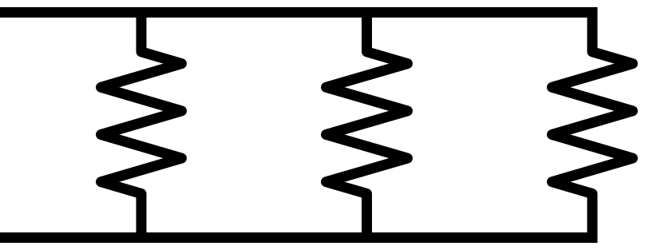
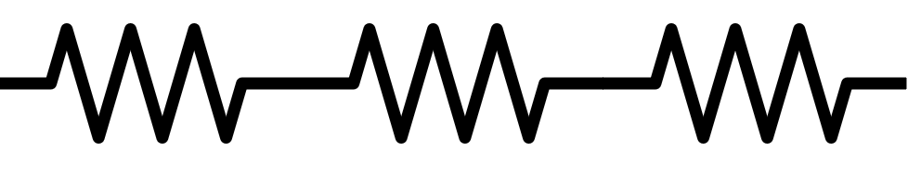
Series and Parallel Connections of Resistors
R₁
R₁
R₂
R₃
R₂
R₃

Slide 10
Steady Current in a Closed Circuit
σ
C
A steady current cannot be maintained in the same direction
in a closed circuit by an electrostatic field.

Slide 11
Nonconservative Field
A steady current in a circuit is the result of the motion of charge carriers, which, in their paths, collide with atoms and dissipate energy in the circuit.
This energy must come from a nonconservative field, since a charge carrier completing a closed circuit in a conservative field neither gains nor loses energy.
σ
C
The sources of the nonconservative field, when connected in an electric circuit, provide a driving force for the charge carriers. This force manifests itself as an equivalent impressed electric field intensity, E_{i}.

Slide 12
Sources of Nonconservative Field
The source of the nonconservative field may be
electric batteries (conversion of chemical energy to electric energy),
electric generators (conversion of mechanical energy to electric energy),
thermocouples (conversion of thermal energy to electric energy), and
photovoltaic cells (conversion of light energy to electric energy).

Slide 13
Electromotive Force (emf)
Electromotive force (emf), denoted ℰ, is the energy supplied per unit charge by a source that drives charge around a circuit.
It is not a force; it is a work per charge quantity.
The SI unit for emf is Volt.
In a closed loop, conservative electric fields alone cannot maintain steady current.
EMF represents the action of nonconservative forces (chemical, mechanical, or electromagnetic) that push charge carriers “uphill” in potential.

Slide 14
Electromotive Force (emf) (cont.)
V₀
E
E
E_{i}
σ
C

Slide 15
Kirchhoff’s Voltage Law (KVL)
Around a closed path in an electric circuit, the algebraic sum of the emf's (voltage rises) is equal to the algebraic sum of the voltage drops across the resistances.

Slide 16
Principle of Conservation of Charge
Electric charge cannot be created or destroyed; at any moment, all charge—whether at rest or in motion—must be fully accounted for.

Slide 17
Equation of Continuity
J
Q
V′
S
Current leaving V′
Charge inside V′

Slide 18
Kirchhoff’s Current Law (KCL)
For steady currents, charge density does not vary with time, ∂ρ/∂t = 0.
Kirchhoff's current law states that the algebraic sum of all the currents flowing out of a junction in an electric circuit is zero.

Slide 19
Relaxation Time
Conductor
ρ(t = 0) = ρ₀
Relaxation time (s)
Copper
σ ≈ 5.8×10⁷S/m
ε ≈ ε₀
τ ≈ 1.52 ×10⁻¹⁹s
Charges introduced in the interior of a conductor will move to the conductor surface and redistribute themselves in such a way as to make ρ = 0 and E = 0 inside under equilibrium conditions.

Slide 20
Power Dissipation
Under the influence of an electric field, conduction electrons in a conductor undergo a drift motion macroscopically.
Microscopically, these electrons collide with atoms on lattice sites. Energy is thus transmitted from the electric field to the atoms in thermal vibration.
The work Δw done by an electric field E in moving a charge q a distance Δl is qE•Δl, which corresponds to a power
where u is the drift velocity. The total power delivered to all the charge carriers in a volume dv is

Slide 21
Joule’s Law
Power density (W/m³)

Slide 22
Power Dissipation in a Uniform Wire
S
+
l
σ
V
₋

Slide 23
Governing Equations for Steady Current Density

Slide 24
Boundary Conditions for Current Density
J₁
σ₁
Medium 1
σ₂
Medum 2
J₂

Slide 25
Current Density at the Interface of Two Conductors
P₁
σ₁
P₂
σ₂
α₁
J₁
α₂
J₂

Slide 26
Surface Charge Density at the Interface of Two Lossy Media
ρ_{s}
J₁
ε₁, σ₁
Medium 1
ε₂, σ₂
Medum 2
J₂

Slide 27
Parallel-Plate Capacitor with Two Lossy Dielectrics
z
ρ_{s1}
S
+
d₁
(ε₁, σ₁)
(E₁, D₁, J₁)
ρ_{sm}
V₀
d₂
(ε₂, σ₂)
(E₂, D₂, J₂)
ρ_{s2}
-

Slide 28
Parallel-Plate Capacitor with Two Lossy Dielectrics (cont.)
z
ρ_{s1}
+
d₁
(ε₁, σ₁)
(E₁, D₁, J₁)
ρ_{sm}
V₀
d₂
(ε₂, σ₂)
(E₂, D₂, J₂)
ρ_{s2}
-

Slide 29
Time Constant of a Two-Conductor System
S
C
+Q
-Q
(ε, σ)

Slide 30
Procedure for Determining Resistance
Choose an appropriate coordinate system for the given geometry.
Assume a potential difference V₀ between conductor terminals.
Find the potential distribution V inside the conductor by solving Laplace's equation, ∇²V = 0, with the applied voltages as boundary conditions.
Compute E = −∇V.
Find current density using the constitutive relation J = σE.
Find total current by integrating the current density over any cross-section:
Calculate resistance by applying Ohm's law:

Slide 31
Resistance Calculation (example)
y
A conducting material of uniform thickness h and conductivity σ has the shape of a quarter of a flat circular washer, with inner radius a and outer radius b.
V = V₀
σ
b
a
V = 0
x

Slide 32
Electrostatics Solutions vs Steady Current Solutions: Homogeneous Medium
Electrostatic
Steady Current
S
+
Homogeneous medium
l
V₀
ε₀, σ > 0
₋

Slide 33
Solutions for a Parallel-Plate Capacitor and a Cylindrical Resistor
S
+
S
+
Homogeneous medium
Homogeneous medium
l
V₀
l
V₀
ε₀, σ = 0
ε₀, σ > 0
₋
₋

Slide 34
Solutions for a Parallel-Plate Capacitor and a Cylindrical Resistor (cont.)
S
+
S
+
Homogeneous medium
Homogeneous medium
l
V₀
l
V₀
ε₀, σ = 0
J_{n} = 0
ε₀, σ > 0
₋
₋

Slide 35
Electrostatics Solutions vs Steady Current Solutions: Inhomogeneous Medium
S
+
Inhomogeneous medium
l
V₀
ε₀, σ
₋

Slide 36
Electrostatics Solutions vs Steady Current Solutions: Inhomogeneous Medium (cont.)
S
+
Inhomogeneous medium
l
V₀
ε₀, σ
₋

