Slide 1
Electromagnetics
Farhad Mazlumi
Assistant Professor
Civil Aviation Technology College, Tehran

Slide 2
Magnetostatics

Slide 3
Magnetic Force
In addition to the electric force, a magnetic force acts on a charged particle only when it is in motion.
The magnetic force F_{m} is:
Proportional to the charge q and its velocity u.
Perpendicular to the direction of motion (F_{m}⊥u).
Does no work on the charge, meaning it can change the particle's direction but not its kinetic energy.
This force is caused by the presence of a magnetic field, denoted by the vector B (magnetic flux density).
F_{m}
u
B
q

Slide 4
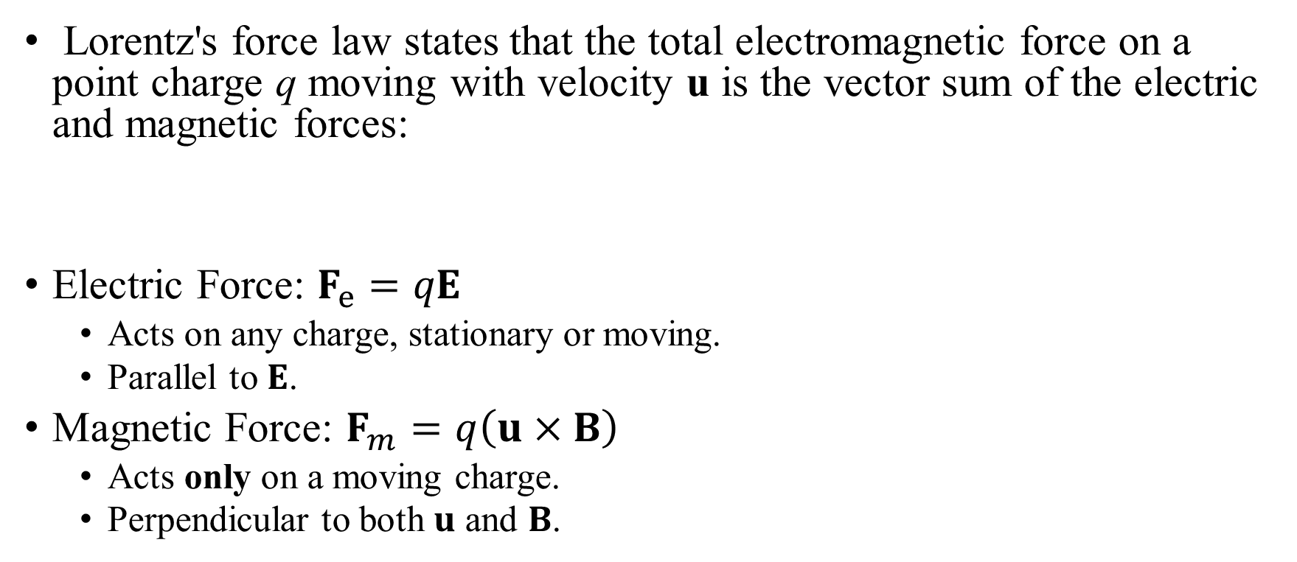
Lorentz’s Force Equation
Lorentz's force law states that the total electromagnetic force on a point charge q moving with velocity u is the vector sum of the electric and magnetic forces:
Electric Force: $F_{e}=qE$
Acts on any charge, stationary or moving.
Parallel to $E$.
Magnetic Force: $F_{m}=q\left(u×B\right)$
Acts only on a moving charge.
Perpendicular to both $u$ and $B$.

Slide 5
Postulates of Magnetostatics in Free Space
Magnetic flux density
(T) or (Wb/m²)
Gauss’s Law for Magnetism
Law of Conservation of Magnetic Flux
Volume current density
(A/m²)
Ampere’s Law
in Free Space
Magnetic permeability of free space
(H/m)

Slide 6
Consistency with KCL for Steady Currents
Ampere’s Law in Free Space
KCL

Slide 7
Gauss’s Law for Magnetism
Differential form
S
V
Integral form

Slide 8
Gauss’s Law for Magnetism (cont.)
There are no magnetic flow sources, and the magnetic flux lines always close upon themselves.
N
S
N
S
N
S
N
S
B
B
N
S
N
S
N
S
✓
✗

Slide 9
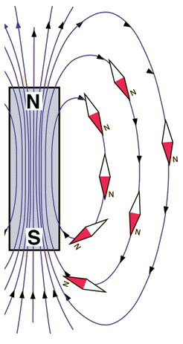
Magnetic Poles
Magnetic poles (North and South) are a descriptive tool for understanding the dipole nature of magnets. They are not fundamental, independent entities like electric charges.
Opposite poles attract and like poles repel (similar to electric charges, but the force acts between dipoles).
Magnetic field lines emerge from the North pole and enter the South pole externally. Inside the magnet, the field lines run from South to North, forming closed loops.

Slide 10
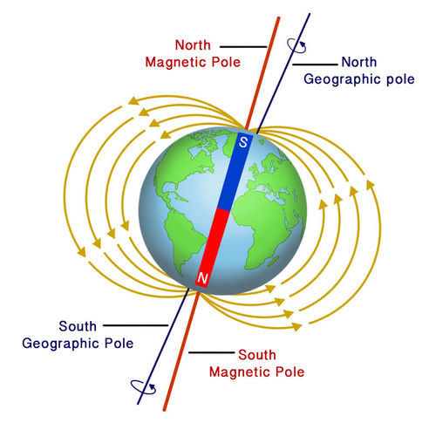
Magnetic Poles (cont.)
The designation of north and south poles is in accordance with the fact that the respective ends of a bar magnet freely suspended in the earth's magnetic field will seek the north and south directions.
Examination of prehistoric rock formations suggests the Earth's magnetic field has reversed dramatically approximately every ten million years.

Slide 11
Magnetic Flux
The magnetic flux Φ through a surface S is the total amount of magnetic field passing through that surface. It is defined as the surface integral of the normal component of the magnetic flux density B:
The SI unit of magnetic flux is the weber (Wb).
Magnetic flux quantifies the linkage of magnetic field lines through a given area. It is a scalar measure of the field's penetration through a surface.

Slide 12
Law of Conservation of Magnetic Flux
The law of conservation of magnetic flux states that the total outward magnetic flux through any closed surface is zero.
Magnetic field lines always form closed loops. There are no magnetic monopoles (isolated sources or sinks of magnetic flux).
S
No magnetic monopole

Slide 13
Ampere’s Law in Free Space
I
Differential form
S
C
Integral form
Ampere’s circuital law: the circulation of the magnetic flux density in free space around any closed path is equal to μ₀ times the total current flowing through the surface bounded by the path.

Slide 14
Postulates of Magnetostatics in Free Space (Differential and Integral Forms)
Differential form
Integral form

Slide 15
Fields of an Infinitely Long Straight Wire
An infinitely long, straight conductor with a circular cross section of radius a carries a steady current I. B = ?
I
z
a
C₁
Due to cylindrical symmetry
C₂

Slide 16
Fields of a Closely Wound Toroidal Coil
A closely wound toroidal coil with an air core having N turns and carrying a current I. The toroid has a mean radius b, and the radius of each turn is a. B = ?
Due to cylindrical symmetry

Slide 17
Fields of a Current-Carrying Long Solenoid
An infinitely long solenoid with air core having n closely wound turns per unit length and carrying a current I. B = ?
N

Slide 18
Vector Magnetic Potential
Vector Magnetic Potential (Wb/m)

Slide 19
Vector Laplacian of a Vector

Slide 20
Vector Laplacian of a Vector (cont.)
The vector Laplacian of a vector field F is defined as:
This identity is not a new operator but a convenient rewriting of the gradient, divergence, and curl operations. It reduces to the familiar scalar Laplacian applied component-wise only in Cartesian coordinates:
In cylindrical or spherical coordinates, the unit vectors themselves depend on position, so the component-wise form is not valid. The general definition above must be used.

Slide 21
Laplacian Operator: Scalar vs. Vector Fields
Laplacian of a scalar field f
Laplacian of a vector field F

Slide 22
Vector Poisson’s Equation
Coulomb gauge
Vector Poisson’s Equation

Slide 23
Why Is the Coulomb Gauge Called a Gauge?
Suppose a point P on a one-dimensional axis. If the origin is not known, the coordinate of P (x_{P}) cannot be determined.
To define the coordinate quantitatively, we must first choose an origin.
The numerical value of the coordinate depends on this choice. If the origin is changed, the coordinate of the same physical point also changes, even though the point itself remains unchanged.
The word “gauge” literally means a choice of measurement.
x_{P} = ?
P
x
P
x
O

Slide 24
Gauge Theory
In some physical theories, the variables used to describe a system are not unique.
Different mathematical descriptions can correspond to the same physical state.
A gauge theory is a theory in which:
There exists a freedom in the description (gauge freedom),
Physical laws depend only on quantities that are independent of this freedom.
Gauge theory is about separating physical information from descriptive redundancy. In other words, a gauge theory formalizes the idea that physics is independent of the chosen measurement or representation

Slide 25
Gauge Theory: Terms and Structure
Gauge Symmetry
Invariance of the physical laws under changes of description
Gauge Freedom
The non-uniqueness of the variables used to describe the system
Gauge Condition
An additional rule used to fix the description uniquely
Gauge Observables
Quantities that do not depend on the choice of description

Slide 26
Gauge Theory (example)
Magnetostatics
The magnetic field B is physical and observable
The vector potential A is not uniquely determined by:
∇×A = B
According to Helmholtz’s theorem, A is uniquely determined only after specifying ∇⋅A
Coulomb Gauge
∇⋅A = 0
Fixes the description
Does not change the magnetic field

Slide 27
Solution of Vector Poisson’s Equation

Slide 28
Solution of Vector Poisson’s Equation (cont.)
Volume current density
V′
J
dv′
R - R′
O

Slide 29
Magnetic Flux in Terms of Magnetic Potential
S
C
dl

Slide 30
Thin Wire Carrying Current
A thin wire with cross-sectional area S carrying current I.
dv′
S
J
dl′
I

Slide 31
Magnetic Potential due to Current-Carrying Wire
Vector magnetic potential due to a thin wire with cross-sectional area S carrying current I.
C
I
dl′
R′
R
O

Slide 32
Magnetic Field due to Current-Carrying Wire
0
?

Slide 33
Gradient of Reciprocal of Distance

Slide 34
Biot-Savart Law
Magnetic flux density due to a thin wire with cross-sectional area S carrying current I.
C
I
dl′
R′
R
O

Slide 35
Magnetic Field of a Current-Carrying Straight Wire
A direct current I flows in a straight wire of length 2L. Find B at a point located at a distance r from the wire in the bisecting plane.
z
L
dz′
z′
R′
r
R
-L

Slide 36

Magnetic Field of a Current-Carrying Straight Wire (cont.)
A direct current I flows in a straight wire of length 2L. Find B at a point located at a distance r from the wire in the bisecting plane.
z
Biot-Savart law
L
dz′
z′
R′
r
R
Ampere’s law
-L

Slide 37
Magnetic Field of a Square Loop Carrying Current
z
The magnetic flux density at the center of a square loop, with side w carrying a direct current I.
I
w
O
z
L
dz′
z′
R′
r
R
-L

Slide 38
Magnetic Field of a Carrying Current Circular Loop
z
z
The magnetic flux density at a point on the axis of a circular loop of radius a that carries a direct current I.
I
R
O
R′
y
ϕ′
a
dl′
x

Slide 39
Magnetic Field of a Small Circular Loop Carrying Current
The magnetic flux density at a point on the axis of a small circular loop of radius a that carries a direct current I.
z
I
R
O
R′
y
ϕ′
a
dl′
x

Slide 40
Magnetic Field of a Small Circular Loop Carrying Current (cont.)

Slide 41
Magnetic Field of a Small Circular Loop Carrying Current (cont.)
z
I
R
O
R′
y
ϕ′
a
dl′
x

Slide 42
Magnetic Dipole
Magnetic dipole is a small current-carrying loop.
Magnetic dipole moment (m) is a vector whose magnitude is the product of the current in and the area of the loop and whose direction is the direction of the thumb as the fingers of the right hand follow the direction of the current.
I
S

Slide 43
Potential and Field of a Magnetic Dipole
z
R
In the far field (R >> a)
I
S
O
y
x

Slide 44
Electric Dipole vs Magnetic Dipole Fields
Electric dipole
Magnetic dipole
z
z
+q
R
R
I
d
O
S
O
-q

Slide 45
Magnetization Vector
The magnetization vector M is a macroscopic, smoothed function that represents the volume density of magnetic dipole moments in a material.
m_{n}: the magnetic dipole moment of n^{th} atom
N: the number of atoms per unit volume
m
Δv
(A/m)

Slide 46
Potential due to Magnetization Vector
Potential due to a magnetic dipole located at origin
V′
dv′
M
R′
R
O

Slide 47
Potential due to Magnetization Vector (cont.)
S′
V′
dv′
M
R′
R
O

Slide 48
Equivalent Magnetic Current Densities
V′
dv′
M
R′
R
O
J_{ms}
V′
dv′
J_{m}
R′
R
O

Slide 49
Uniformly Magnetized Circular Cylinder
z
A uniformly magnetized circular cylinder of a magnetic material. The cylinder has a radius a, length L, and axial magnetization
L
M
J_{ms}
a
O

Slide 50
Uniformly Magnetized Circular Cylinder (cont.)
z
z
I
z - z′
z
P(x = 0, y = 0, z)
L
I
z′
dz′
J_{ms}
O
y
a
O
a
x

Slide 51
Magnetic Field Intensity
J: Volume current density of free current
J_{m}: Equivalent volume current density due to magnetization
J_{m}
J
Ampere’s law
Magnetic field intensity (A/m)

Slide 52
Ampere’s Circuital Law
I
Ampere's circuital law states that the circulation of the magnetic field intensity around any closed path is equal to the free current flowing through the surface bounded by the path.
S
C

Slide 53
Magnetic Susceptibility
In linear and isotropic medium, the magnetization is directly proportional to the magnetic field intensity:
χ_{m} is a dimensionless quantity.
Magnetic susceptibility

Slide 54
Magnetic Permeability
In a linear and isotropic medium
μ_{r}
Relative permeability
Absolute permeability (H/m)
Permeability of free space

Slide 55
Behavior of Magnetic Materials
Magnetic materials can be roughly classified into three main groups in accordance with their μ_{r} values.
A material is said to be
Diamagnetic, if μ_{r} < 1 (χ_{m} is a very small negative number).
Paramagnetic, if μ_{r} > 1 (χ_{m} is a very small positive number).
Ferromagnetic, if μ_{r} 1 (χ_{m} is a large positive number).
∼
∼

Slide 56
Magnetic Circuits
A magnetic circuit is an engineering model that simplifies the analysis of magnetic fields in ferromagnetic structures, analogous to how electric circuit theory simplifies the analysis of currents.
Ferromagnetic materials (like iron) have a high permeability (μ ≫ μ₀), which confines magnetic flux to paths largely within the material, much like wires confine electric current. This confinement enables the use of simplified "circuit" concepts.
The goal of a magnetic circuit analysis is to determine the magnetic flux (Φ) and field intensity (H) in various parts of a structure created by current-carrying windings around ferromagnetic cores.

Slide 57
Magnetic Circuits (cont.)
The model of magnetic circuits is essential for designing and analyzing:
Transformers
Electric Generators & Motors
Electromagnets & Relays
Magnetic Recording Heads & Inductors

Slide 58
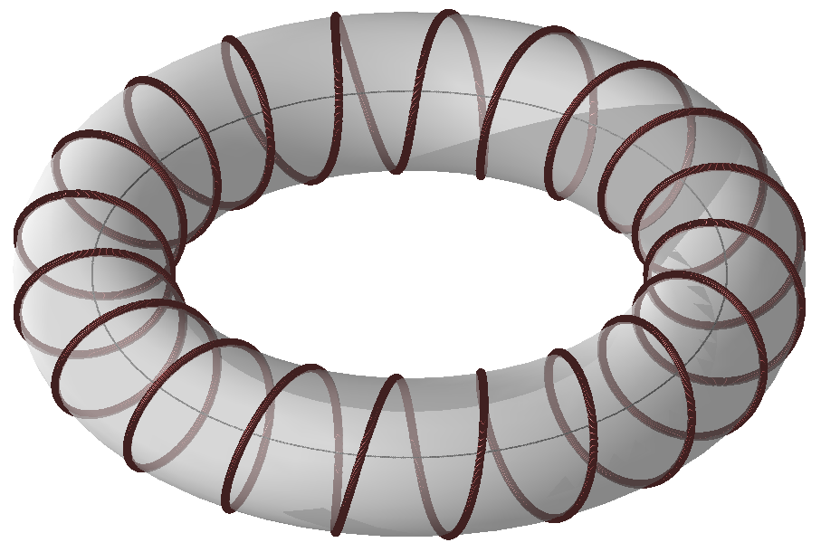
Magnetic Circuits (cont.)
Ferromagnetic core
I
N-turn winding carrying current I
C

Slide 59
Magnetic Circuits (cont.)
Ferromagnetic core
NI
I
N-turn winding carrying current I
C

Slide 60
Magnetomotive Force (mmf)
Magnetomotive force (mmf) is the cause that drives magnetic flux through a magnetic circuit.
It is analogous to electromotive force (emf) in an electric circuit.
For a coil of N turns carrying current I, the mmf is ℱ = NI.
Its SI unit is the ampere (A), but it is often expressed as ampere-turns (A·t).
Important: mmf is not a mechanical force (in Newtons). It is an electromagnetic potential.
In a magnetic circuit, mmf, flux (Φ), and reluctance (ℛ) are related by Hopkinson's Law: ℱ = Φℛ.

Slide 61
Reluctance
Reluctance (ℛ) is the opposition a material offers to magnetic flux, analogous to electrical resistance.
For a uniform magnetic path, it is calculated as: ​
l: length of the path
S: cross-sectional area
μ: permeability of the material (μ = μ₀μ_{r}​)
Its SI unit is ampere per weber (A/Wb) or inverse henry (H⁻¹).
Low reluctance means the material is a good conductor of magnetic flux (e.g., iron).
High reluctance means the material strongly opposes flux (e.g., air).
It is the key parameter in Hopkinson's Law (the magnetic Ohm's Law): ℱ = Φℛ, where ℱ is the magnetomotive force.

Slide 62
Laws of Magnetic Circuits
N₁I₁
Φ
N₂I₂
Φ₄
Φ₃
Φ₁
Φ₂

Slide 63
Magnetic Circuits (example)

Slide 64
Boundary Conditions for Magnetic Fields
H₁
μ₁
Medium 1
H₂
μ₂
Medum 2

Slide 65
Magnetic Field at a Current-Free Interface
Two dielectric media with permeabilities μ₁ and μ₂ are separated by a current-free boundary. The magnetic field intensity in medium 1 at the point P₁ has a magnitude H₁ and makes an angle α₁ with the normal. Find H₂ and α₂.
P₁
μ₁
P₂
μ₂
α₁
H₁
α₂
H₂

Slide 66
Magnetic Field at a Current-Free Interface (cont.)
If medium 1 is nonmagnetic (like air) and medium 2 is ferromagnetic (like iron), then μ₂ >> μ₁, and
α₂ will be nearly 90°. This means that for any arbitrary angle α₁ that is not close to zero, the magnetic field in a ferromagnetic medium runs almost parallel to the interface.
α₁ will be nearly zero; that is, if a magnetic field originates in a ferromagnetic medium, the flux lines will emerge into air in a direction almost normal to the interface.
α₁
Air
μ₁
Iron
α₂
μ₂
Air
μ₁
Iron
μ₂
α₂

Slide 67
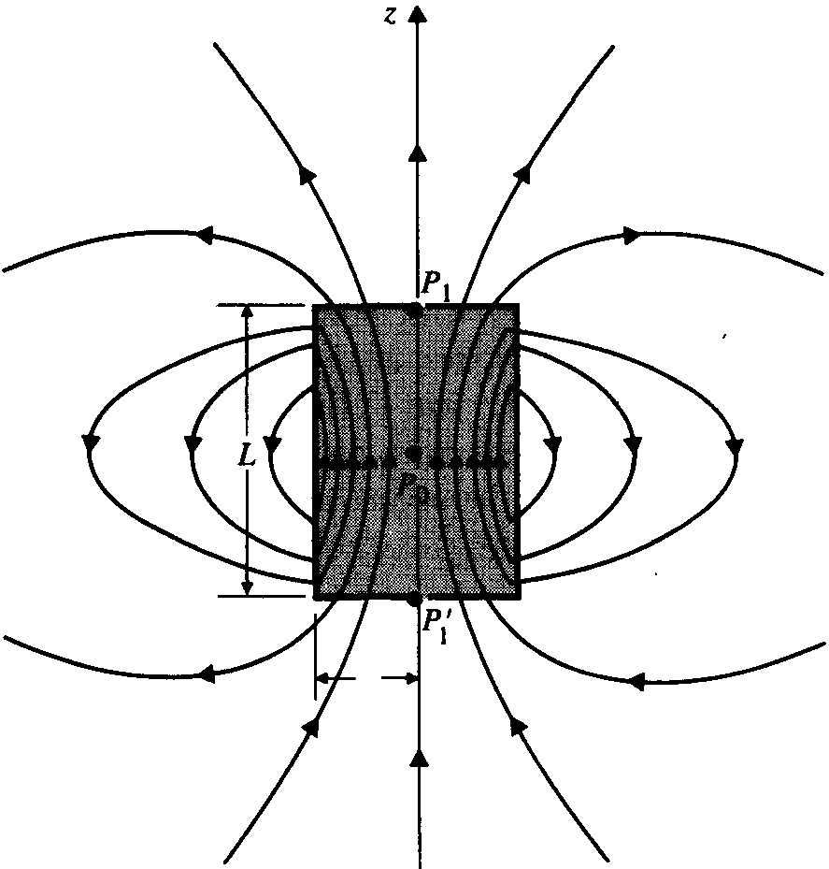
Magnetic Flux Lines of a Cylindrical Bar Magnet
Magnetic flux lines both inside and outside a cylindrical bar magnet having a uniform axial magnetization
z
L
J_{ms}
a
a
O

Slide 68
Two Magnetically Coupled Loops
B₁
S₂
C₁
S₁
I₁
Mutual inductance between two loops
(H)

Slide 69
Flux Linkage
Flux linkage is a measure of how magnetic flux is linked with an electrical circuit. It is a measure of how many times magnetic flux lines are "threaded through" or linked with the turns of a conducting loop.
For a single conducting loop, the flux linkage equals the magnetic flux through the surface bounded by the loop:
For a coil consisting of N turns, the total flux linkage is defined as the sum of the fluxes linked with each turn:
If the same magnetic flux Φ passes through every turn (uniform flux and identical turns), this reduces to:
This expression assumes that each turn encloses the same magnetic flux and carries the same current.

Slide 70
Geometric Interpretation of Flux Linkage
Flux linkage can be visualized as an effective multiplication of area by the number of turns.
If a magnetic flux Φ passes through each turn of a coil with N identical turns, the coil behaves equivalently to a single loop whose effective area is N times larger, linking N times more flux. Thus, the total flux linkage is
Λ = NΦ
This can be interpreted as:
Λ = Φ × (effective number of surfaces pierced by the flux)
This is a geometric interpretation only; the physical area of the coil does not change—rather, the same flux is counted once for each turn it links.

Slide 71
Flux vs Flux Linkage
Magnetic flux describes the field in space; flux linkage describes how that field is connected to a specific conducting circuit.
Flux is a field quantity.
Defined everywhere in space
Depends only on the magnetic field and a chosen surface
Exists whether or not a conductor is present
Does not care how many wires or turns are nearby
Flux linkage is a circuit quantity.
Flux linkage is not a property of space — it is a property of a circuit placed in space.
Defined only with respect to a specific conducting circuit
Depends on:
the number of turns
the geometry of the conductors
which parts of the flux actually link the circuit
Counts how many times magnetic flux is linked with the conducting path.

Slide 72
Mutual Inductance between Two Circuits
The mutual inductance between two circuits is the magnetic flux linkage with one circuit per unit current in the other.
B₁
Magnetic flux density due to current I₁
N₂
turns
S₂
Magnetic flux
Circuit 2
C₁
Flux linkage
N₁
turns
S₁
Circuit 1
I₁
Mutual inductance
(H)

