Slide 1
Antenna Basics
Farhad Mazlumi

Slide 2
Contents
2
Introduction
Applications
Power flow
Radiation characteristics
Near and far field
Antenna measurement
Notes:
Radiate to and receive from desired direction.

Slide 3
Introduction
3

Slide 4
Definition
4
“A usually metallic device (as a rod or wire) for radiating or receiving radio waves.”
---Webster’s dictionary
“A means for radiating or receiving radio waves.”
---IEEE Standard Definitions
Notes:
Radiate to and receive from desired direction.

Slide 5
Role of antenna
5
Guiding device
Antenna
Free space
Waveguide
Transmission line
Electromagnetic waves
Horn antenna
EM wave
Waveguide

Slide 6


Mode of operation
6
Transmission: antenna radiates power.
Reception: antenna receives power.
Transmission and reception

Slide 7
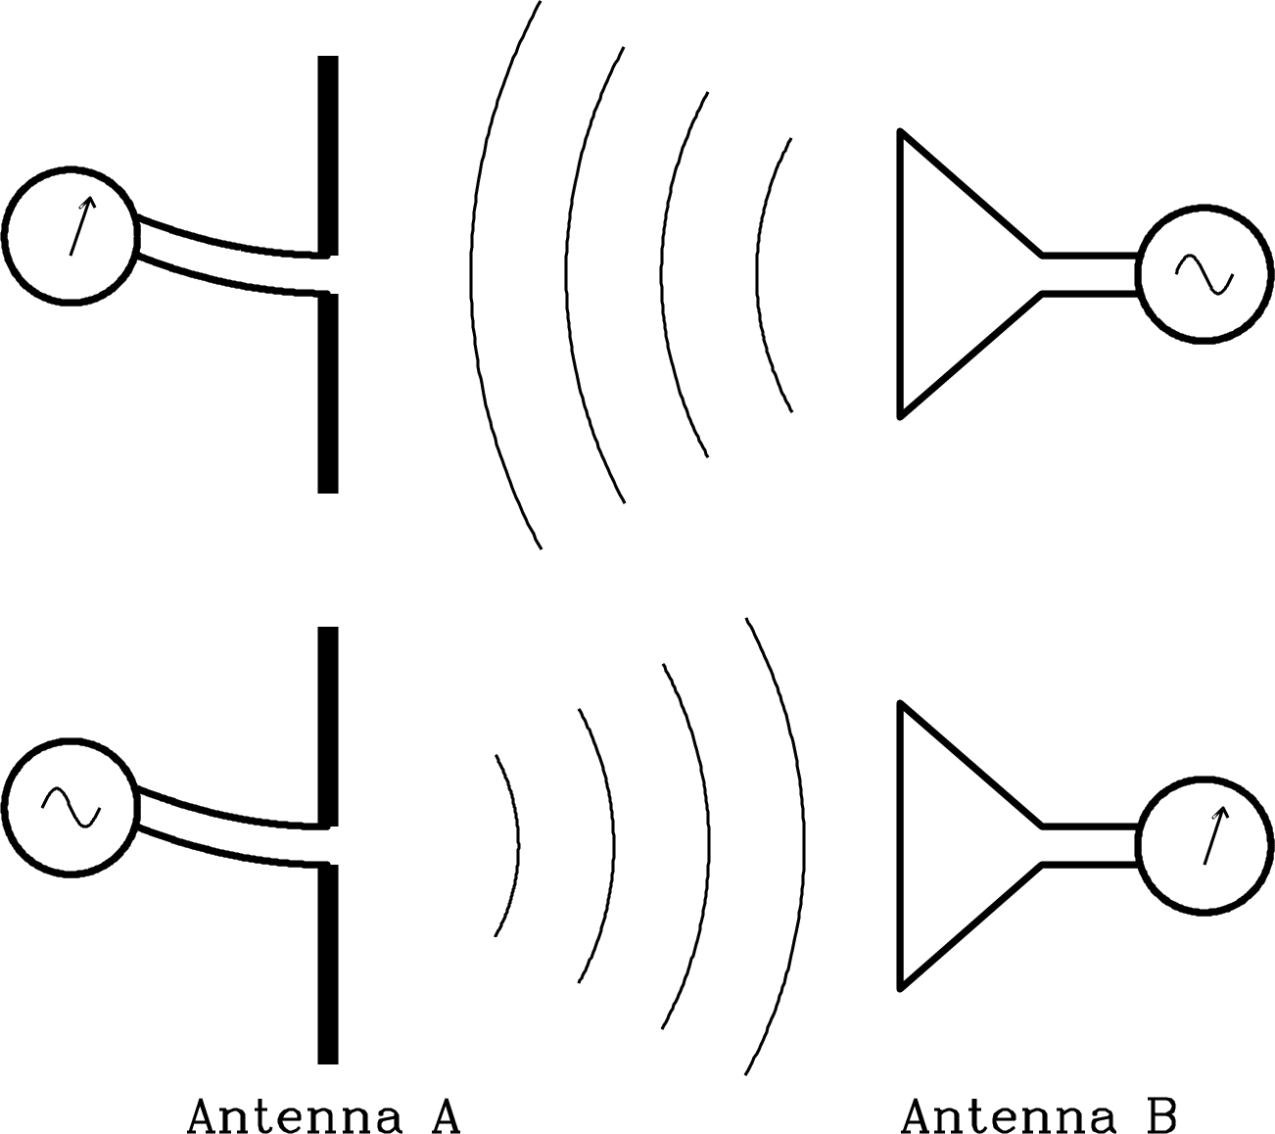
Reciprocity
7
Receive properties = Transmit properties
Note: it is easier to study antenna in transmission mode.

Slide 8
Applications
8

Slide 9
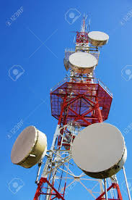
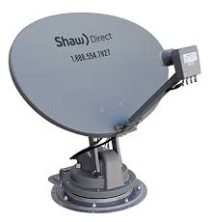
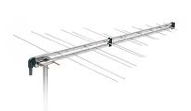
Applications
9
Wireless communication

Slide 10
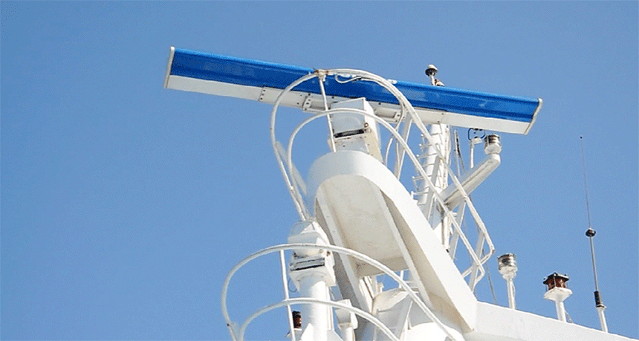
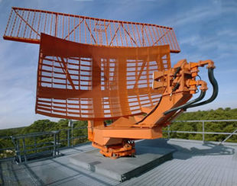
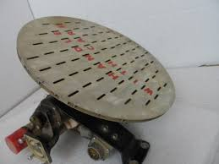
Applications
10
RADAR

Slide 11
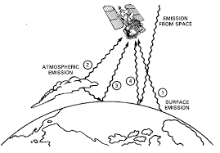
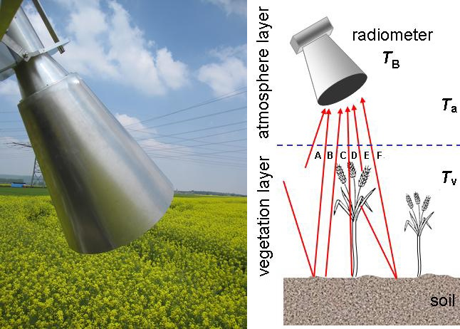
Applications
11
Remote sensing

Slide 12
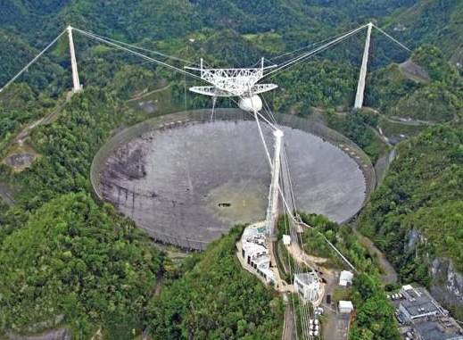
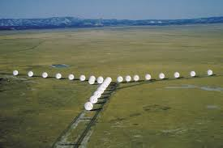
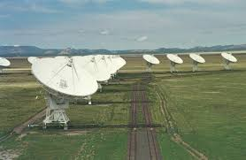
Applications
12
Radio telescope

Slide 13

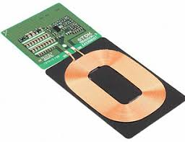
Applications
13
Energy harvesting and wireless charging

Slide 14
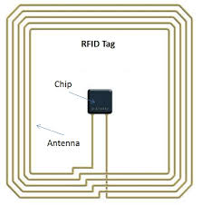
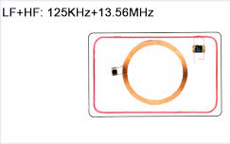
Applications
14
RFID

Slide 15
Source of radiation
15
Electric potential
Magnetic potential
Charge density
Current density
Electric field intensity
Retarded time
Velocity
J
dv'
V
R'
R
o

Slide 16
Source of radiation
16
Sources of radiation
Time varying current
Accelerated electric charge

Slide 17
Source of radiation
17
Electric charge
Acceleration or Deceleration
Radiation

Slide 18
Source of radiation
18
Acceleration/Deceleration
Change of speed
Change of direction

Slide 19
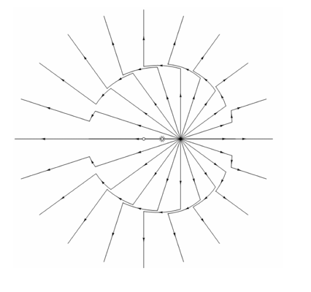
Source of radiation
19
Retardation is what makes it possible for a charged particle to radiate.
https://www.compadre.org/osp/EJSS/4126/154.htm

Slide 20
Source of radiation
20
Does radiate
Does NOT radiate
Alternating current (AC)
Transmission line
Antenna

Slide 21
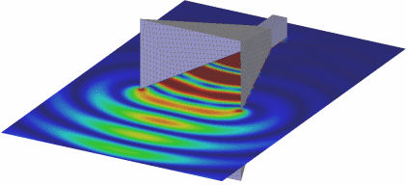
Radiation mechanism
21

Slide 22
Power flow
22

Slide 23
Power flow
23
Guiding device
Antenna
Input power
Radiated power
Reflected power
Dissipated power
Abrupt transition and change of characteristic impedance
Non-ideal conductor
Non-ideal dielectric

Slide 24
Field and power reflection
24
(Field) reflection coefficient
Power reflection coefficient
Transmission line
Antenna
P_{i}
P_{r}

Slide 25
Return loss
25
Return loss (in dB):
P_{r}: reflected power
P_{in}: input power
Γ: field or voltage reflection coefficient
Notes:
Just mention about VSWR

Slide 26
Return loss table
26

Slide 27
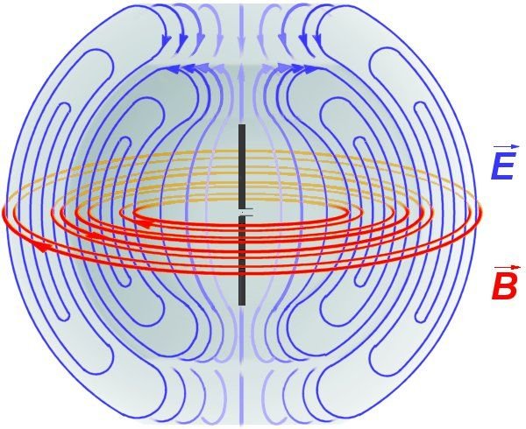
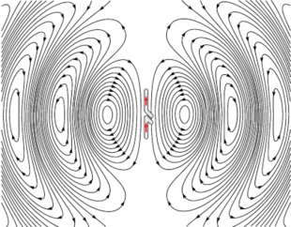
Radiated power
27
A transmitter antenna produces electromagnetic waves.

Slide 28

Power of EM waves
28
Electromagnetic waves carry power.

Slide 29
Radiation characteristics
29

Slide 30

Direction of radiation
30
An antenna with finite dimensions can NOT direct all of the radiated power toward the desired direction.
Each antenna has a radiation pattern.

Slide 31
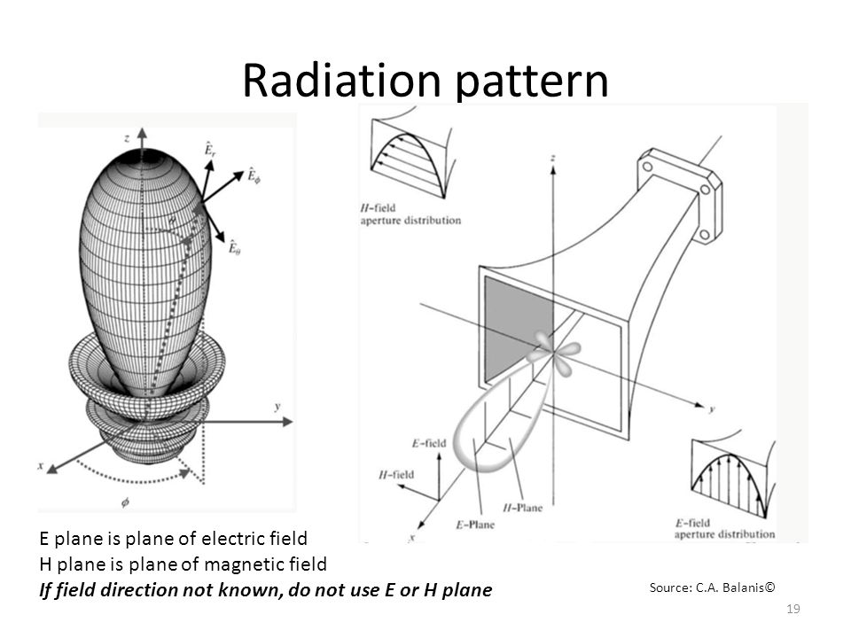
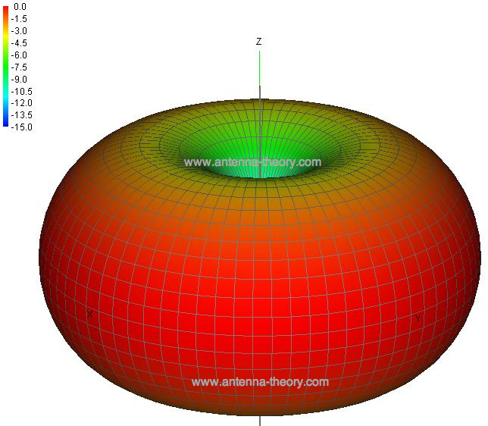
Radiation pattern
31
Radiation pattern: the directional (angular) dependence of the strength of the EM waves radiated from the antenna.
Radiation pattern is usually plotted in polar system.

Slide 32
Principal patterns
32
E-plane: the plane containing
the electric field vector and
the direction of maximum radiation.
H-plane: the plane containing
the magnetic field vector and
the direction of maximum radiation.

Slide 33
Types of plots
33
Scale
Linear
Logarithmic (in dBi)
Coordinate
Polar
Cartesian

Slide 34
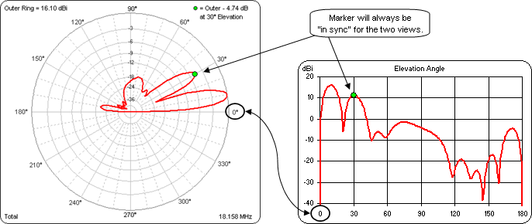
2D cartesian and polar plots
34

Slide 35
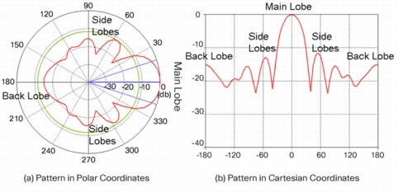
Normalized pattern
35

Slide 36
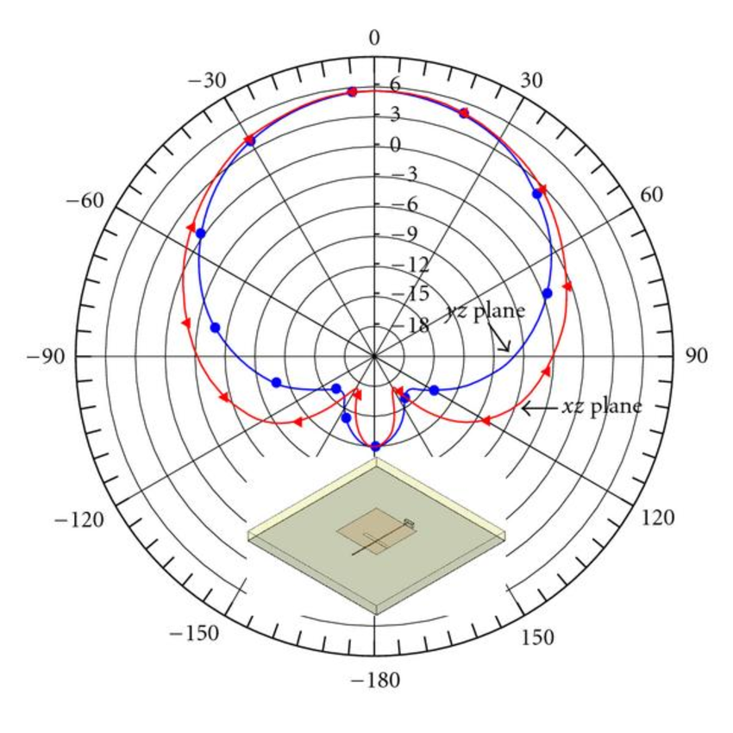
Example of a 2D radiation pattern
36

Slide 37
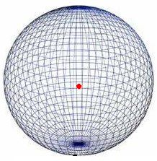
Types of antenna pattern
37
Isotropic: antenna radiates equally in all directions in 3D space (theoretically impossible to realize).

Slide 38
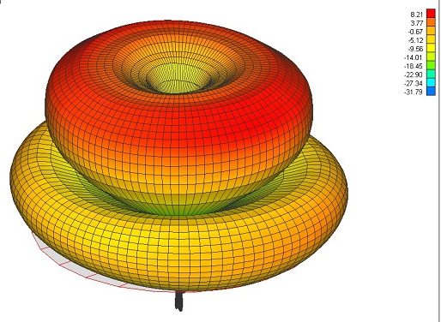
Types of antenna pattern
38
Omnidirectional: radiation response is constant in one of the principal planes.

Slide 39
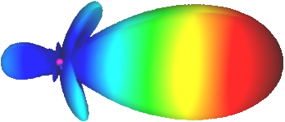
Types of antenna pattern
39
Directional: an antenna which radiates or receives greater power in specific directions.

Slide 40
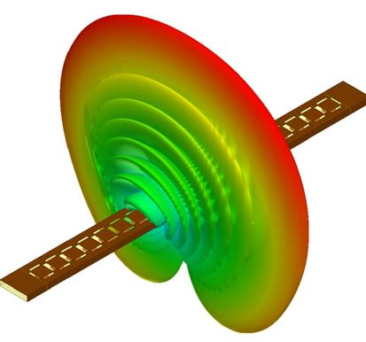
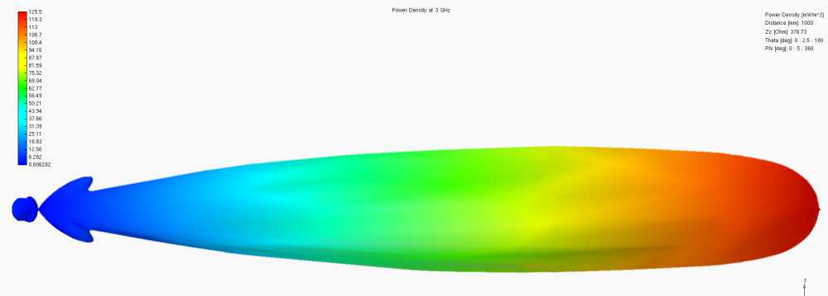
Types of directional patterns
40
Fan beam: a directional antenna producing a main beam having a narrow beamwidth in one dimension and a wider beamwidth in the other dimension.
Pencil beam: a highly directive antenna pattern consisting of a single major lobe contained within a cone of small solid angle and almost circularly symmetrical about the direction of peak intensity

Slide 41
Directivity
41
A measure of how “directional” an antenna's radiation pattern is.
The directivity of isotropic antenna is 1 (or 0 dB).
Isotropic pattern
Directional pattern

Slide 42
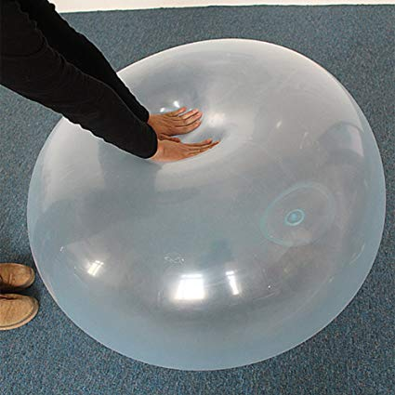

Directivity
42

Slide 43
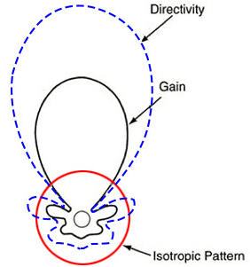
Gain
43
Gain is a product of the directivity and the efficiency of an antenna.
η_{rad}: antenna radiation efficiency
Note: power lost due to joule heating in the feedline and reflections back down the feedline are not included in antenna radiation efficiency.

Slide 44
Realized gain
44
The realized gain of an antenna is calculated by the product of the total efficiency of the antenna and its directivity.

Slide 45
Total efficiency
45
The total efficiency (η_{tot}) of the antenna considers
Losses due to reflections at the input terminals
Losses within the structure of the antenna
Dielectric losses
Conductor losses
Antenna
Transmission line
P_{in}
P_{rad}
P_{r}
P_{a}

Slide 46
Directivity, gain, and realized gain
46
Antenna
Transmission line
P_{in}
P_{rad}
P_{r}
P_{a}

Slide 47
Characteristics of an antenna pattern
47
Main lobe
Beam width
Half power beam width (-3dB beam width)
-10dB beam width
First null beam width
Maximum gain
Minor lobes
Side lobe
Side lobe level (SLL)
Back lobe
Back lobe level

Slide 48
Characteristics of an antenna pattern
48

Slide 49
Side Lobe Level (SLL)
49
Level of the worst sidelobe relative to the peak of the main lobe measured in dB.
M
S

Slide 50
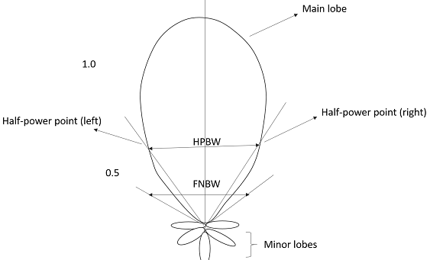
Half Power Beam Width (HPBW)
50
HPBW or BW_{-3dB}: the angle between the half-power (-3 dB) points of the main lobe, when referenced to the peak power of the main lobe.

Slide 51
Polarization
51

Slide 52
Polarization of an antenna
52
Polarization of an antenna: the polarization of the wave transmitted (radiated) by the antenna.
NOTE: When the direction is not stated, the polarization is taken to be the polarization in the direction of maximum gain.

Slide 53
Polarization of a wave
53
Polarization of a radiated wave specifies the geometrical orientation of the electric field oscillations.
.Types of polarizations
Linear: vertical, horizontal, slant
Circular: right-hand, left-hand
Elliptical: right-hand, left-hand

Slide 54
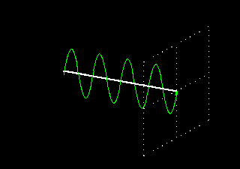
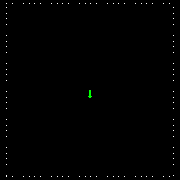
Linear polarization: Vertical
54

Slide 55
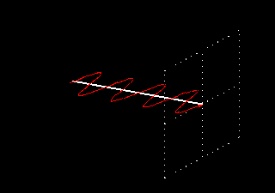
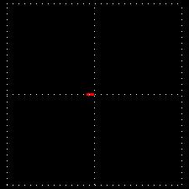
Linear polarization: Horizontal
55

Slide 56
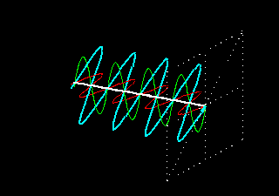
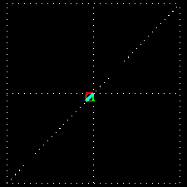
Linear polarization: Slant
56

Slide 57
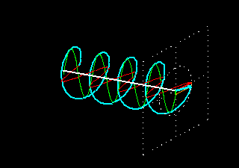
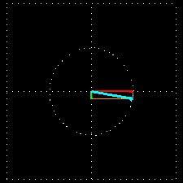
Circular polarization: Left hand
57

Slide 58
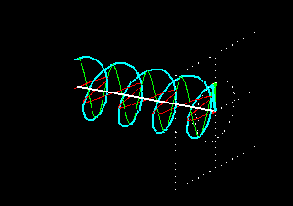
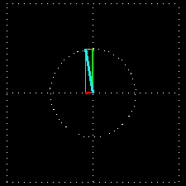
Circular polarization: Right hand
58

Slide 59
Elliptical polarization
59
Axial Ratio (AR) = OA/OB
Linear: AR → ∞
Circular: AR = 1
Elliptical: 1 < AR < ∞

Slide 60
Co- and Cross- polarizations
60
Co-Polarization: defined as the polarization the antenna is meant to radiate,
Cross-Polarization: defined as the polarization orthogonal to its co-polarized pair.
Polarization pairs
Vertical / Horizontal
Slant +45 / Slant -45
Right-Hand Circular Polarization (RHCP) / Left-Hand Circular Polarization (LHCP)

Slide 61
Near and far fields
61

Slide 62
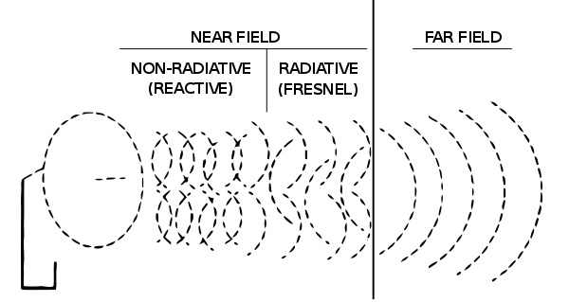
Near and far fields
62
D
Falloff rate of field:

Slide 63
Near and far fields
63

Slide 64
Antenna measurement
64

Slide 65
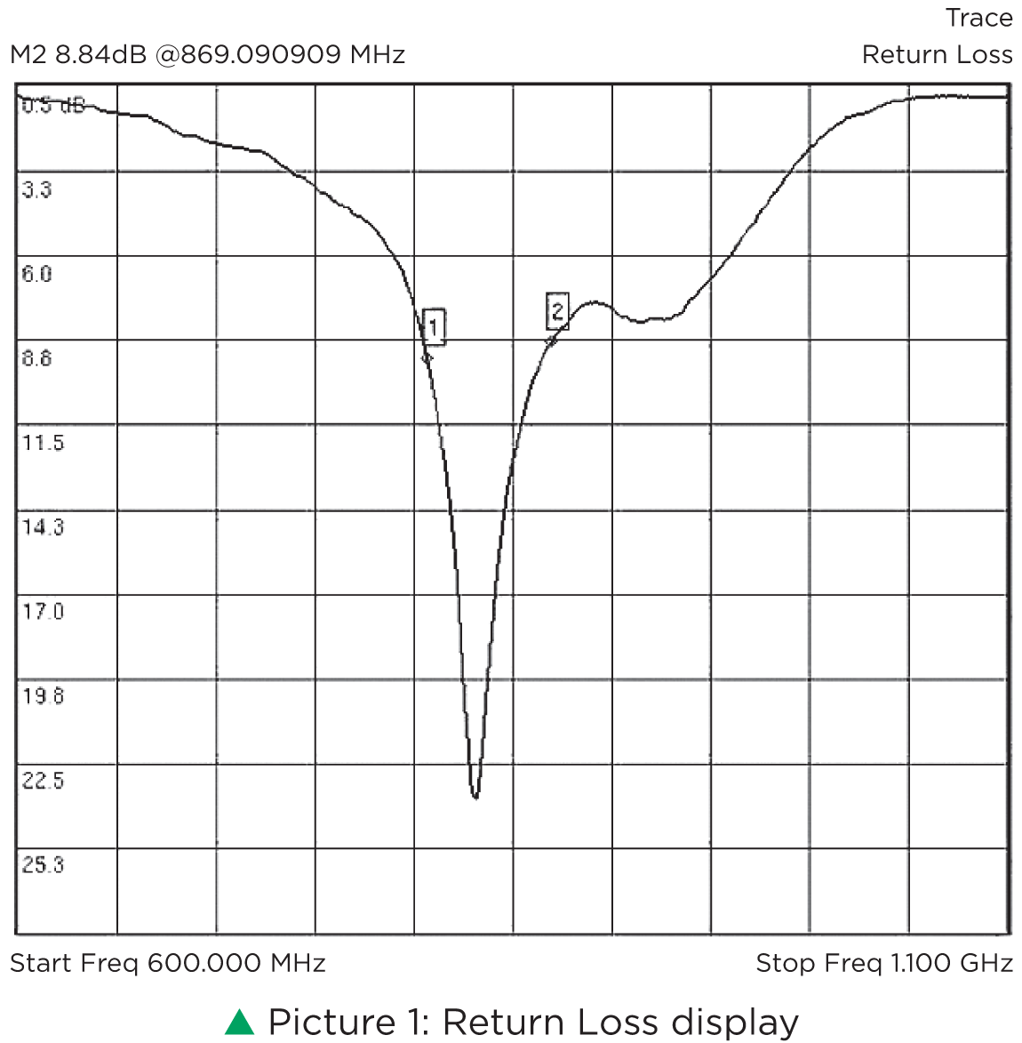
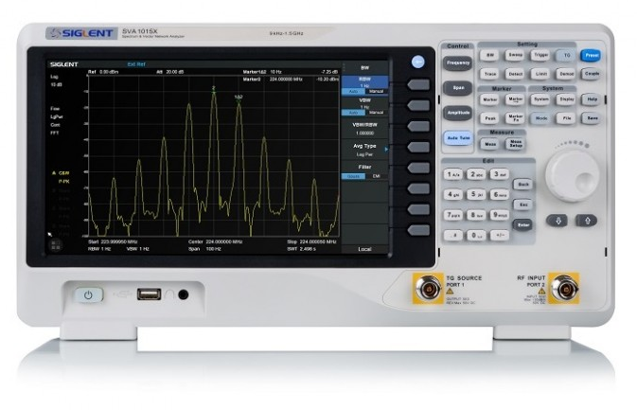
Antenna measurement: return loss
65
Network analyzer

Slide 66
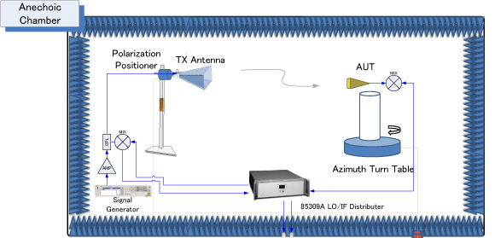
Antenna measurement: pattern
66

Slide 67
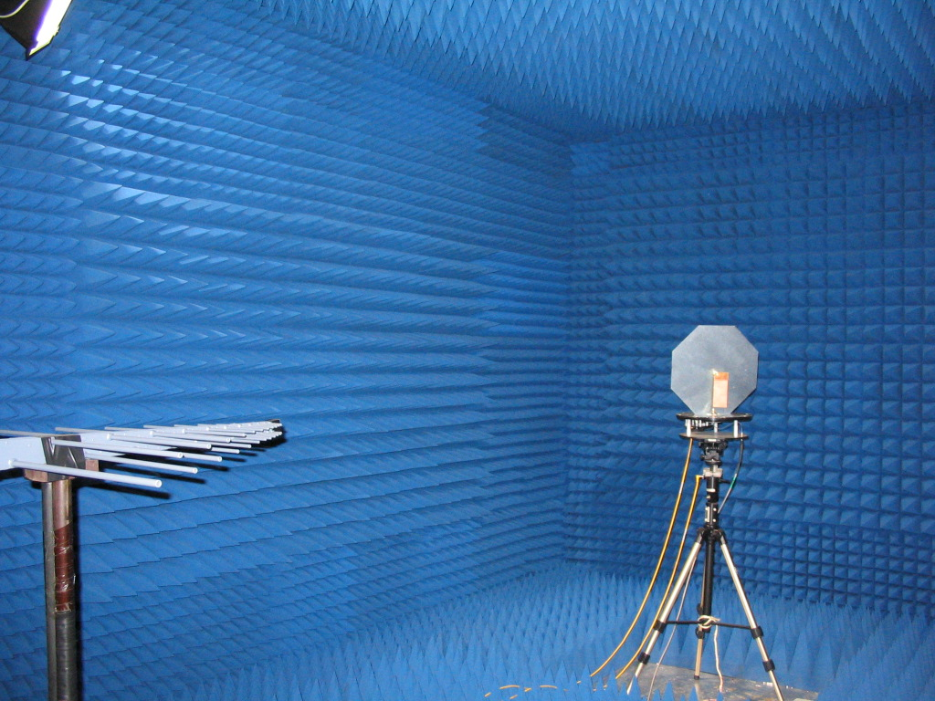
Anechoic chamber
67

Slide 68
Approximate relations
68

Slide 69
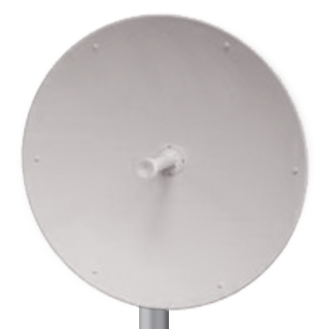
Approximate relations
69
Gain in terms of aperture
A_{p}

Slide 70
Approximate relations
70
Gain in terms of beamwidth
HPBW_{e}
HPBW_{h}

Slide 71
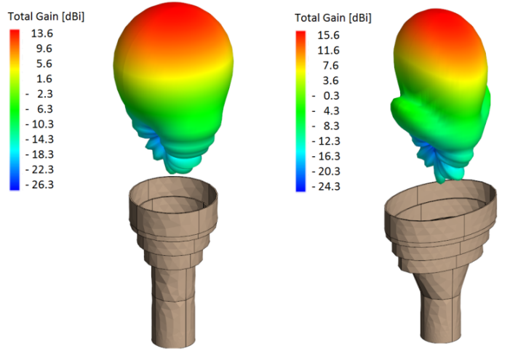
Approximate relations
71
Beamwidth

