Slide 1
Microwaves
Network Analysis
Farhad Mazlumi
Civil Aviation Technology College

Slide 2
Why Network Analysis?
Only interested in the voltage or current at a set of terminals, the power flow through a device, or some other type of “terminal” quantity.
Easy to modify the original problem, or combine several elements together and find the response, without having to reanalyze in detail the behavior of each element in combination with its neighbors.
Port 1
Port 2
Network
E, H
Port 3
Port 4

Slide 3
Port
A port consists of two nodes (terminals) connected to an outside circuit which meets the port condition – the currents flowing into the two nodes must be equal and opposite.
I
+
One-port network
Port
V
-
I

Slide 4
One Port
S: Complex power
P: Active power (real power)
Q: Reactive power
W_{m}: Stored magnetic energy
W_{e}: Stored electric energy
Z_{in}: Input impedance
I
+
One-port network
V
-
I
Z_{in}

Slide 5
Properties of Input Impedance and Reflection
I
+
One-port network
R_{in}(ω): even
X_{in}(ω): odd
|Γ (ω)|: even
∠Γ (ω): odd
V
-
I
Z_{in}

Slide 6
Two-Port Network
I₁
I₂
+
Two-port network
+
Port 1
V₁
V₂
Port 2
-
-

Slide 7
Impedance Matrix
+
Two-port network
+
I₁
↑
V₁
V₂
↑
I₂
-
-
V
Z
I

Slide 8
Admittance Matrix
I₁
I₂
+
Two-port network
+
+
-
V₁
V₂
+
-
-
-
I
Y
V

Slide 9
Transfer Matrix (ABCD Matrix)
I₁
I₂
+
Two-port network
+
V₁
V₂
-
-
T
Notes:
For calculating each parameter, the configuration of port 2 changes, but the sources are always connected to port 1.

Slide 10
Reciprocal Network
A reciprocal network in circuit or microwave theory is typically composed of passive components and does not include
active devices,
ferrites, or
plasmas.

Slide 11
Incident and Reflected Voltage
I₁
I₂
+
Two-port network
+
Z₀
V₁
V₂
Z₀
-
-
Notes:
Assuming the characteristic impedances of the two ports are identical and real.

Slide 12
Incident and Reflected Power
I₁
I₂
+
Two-port network
+
Z₀
V₁
V₂
Z₀
-
-
Incident power
Reflected power
Notes:
Assuming the characteristic impedances of the two ports are real.

Slide 13
Scattering Matrix
I₁
I₂
+
Two-port network
+
Z₀
V₁
V₂
Z₀
-
-

Slide 14
Standard Scattering Matrix
Assumes all ports have identical, real characteristic impedance.
Simpler to calculate and analyze.

Slide 15
Incident and Reflected Power Wave Amplitudes
I
+
Network
a
Z₀
V
b
-
Incident power wave amplitude
Reflected power wave amplitude
Incident power
Reflected power

Slide 16
Incident and Reflected Power Wave Amplitudes
I₁
I₂
+
Two-port network
+
Z₀
V₁
V₂
Z₀
-
-
Assuming the characteristic impedances of the two ports are identical and real.
Notes:
Assuming the characteristic impedances of the two ports are identical and real.

Slide 17
Generalized Scattering Matrix
I₁
I₂
+
Two-port network
+
Z₀
V₁
V₂
Z₀
-
-

Slide 18
Properties of Scattering Matrix
Reciprocal network → symmetrical matrix
Lossless network → unitary matrix
H: Hermitian transpose (conjugate transpose)

Slide 19
Properties of Scattering Matrix

Slide 20
Shifting Reference Planes
S
l₁
l₂
Two-port network
Z₀, β₁
Z₀, β₂
S´

Slide 21
Insertion Loss and Return Loss
I₁
I₂
+
Two-port network
+
Z₀
V₁
V₂
Z₀
-
-
Return Loss in dB
Insertion Loss in dB

Slide 22
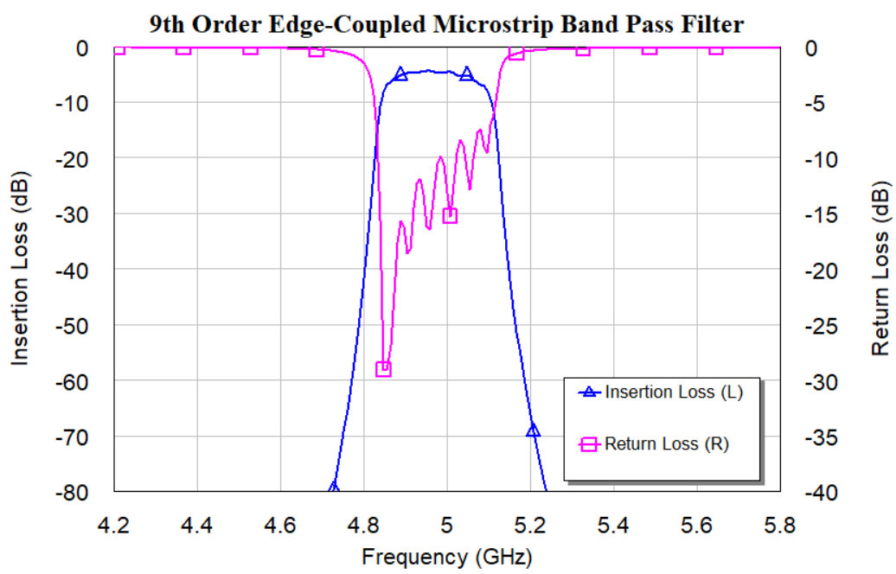
Filter

Slide 23
Isolator
1
2

Slide 24
Three-Port Network (T-Junction)
Three-port network
Port 2
Port 3
Port 1
A lossless, reciprocal three-port network cannot be simultaneously matched at all three ports.

Slide 25
Non-Reciprocal, Lossless Three-Port Network
Matched at all three ports
Matched at all three ports
3
2
3
2
Circulators
1
1

Slide 26
Reciprocal, Lossless Three-Port Network
1
2
Matched at only two ports
3

Slide 27
Four-Port Network
Symmetric directional coupler

Slide 28
Four-Port Network
Antisymmetric directional coupler
Note: these two symmetric and antisymmetric couplers differ only in the choice of reference planes.

Slide 29
Four-Port Network

Slide 30
Directional Coupler
Coupling in dB
Isolation in dB
Directivity in dB

Slide 31
Hybrid Couplers
Hybrid couplers are special cases of directional couplers, where the coupling factor is 3 dB, which implies that
90° hybrid (quadrature hybrid)
180° hybrid (e.g. Magic-T hybrid or Rat-race hybrid)

Slide 32
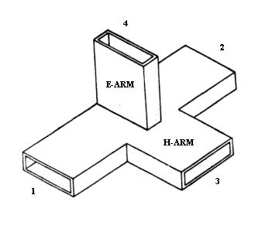
Magic-T or Hybrid Tee

Slide 33
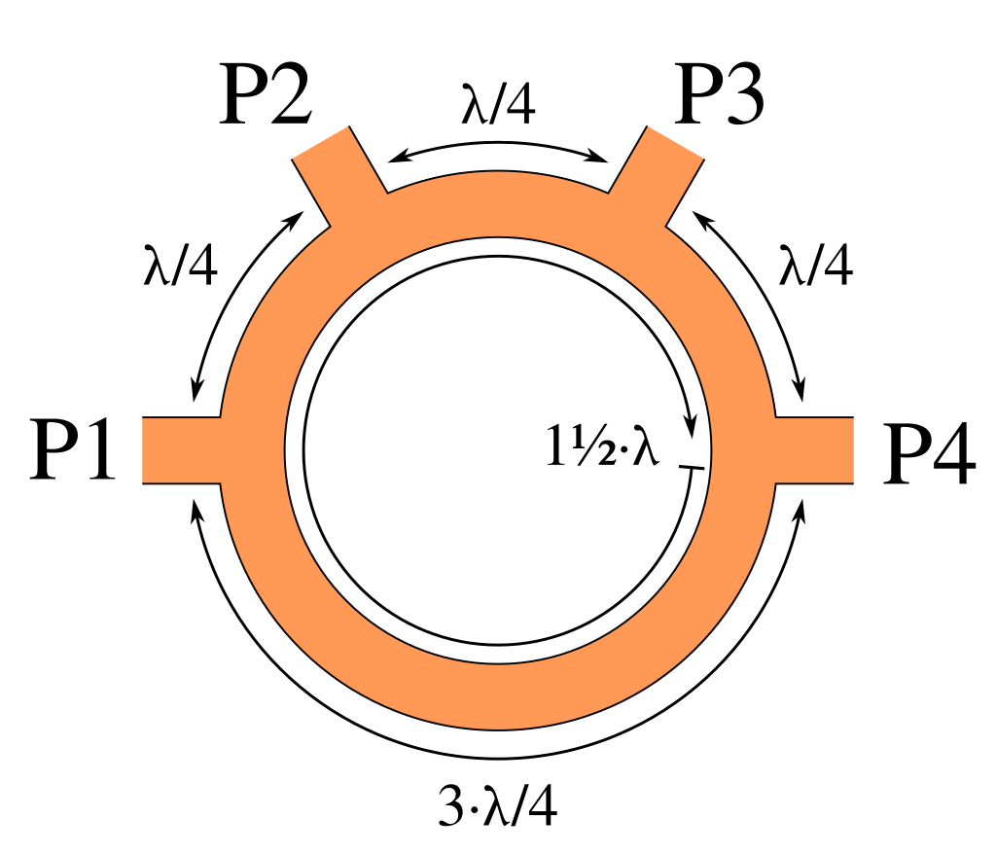
Rat-Race Coupler

Slide 34
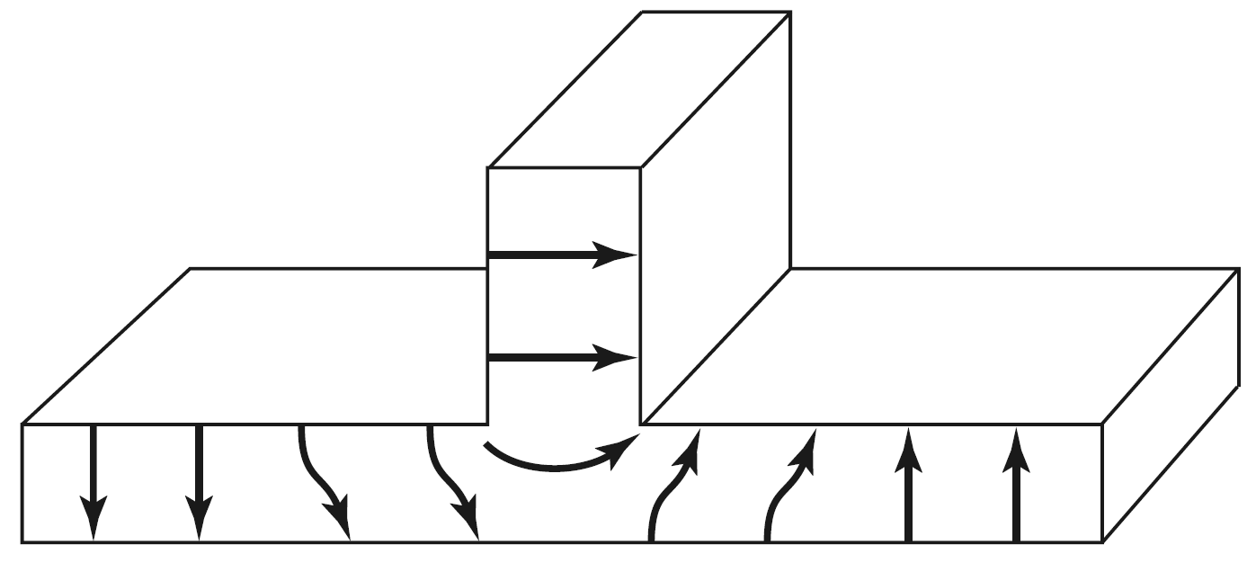
Lossless T-Junction Power Divider
1
3
2
E-plane waveguide T

Slide 35
Lossless T-Junction Power Divider
3
2
1
H-plane waveguide T

Slide 36
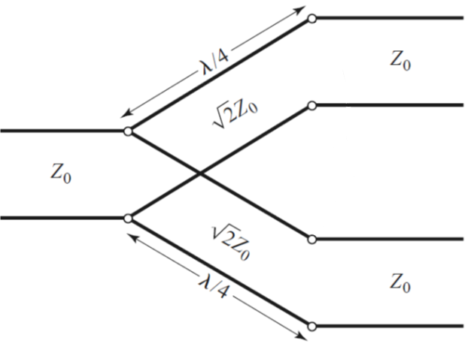
Lossless T-Junction Power Divider
2
1
3

Slide 37
Lossy T-Junction Power Divider
2
2
1
1
3
3
Wilkinson power divider

Slide 38
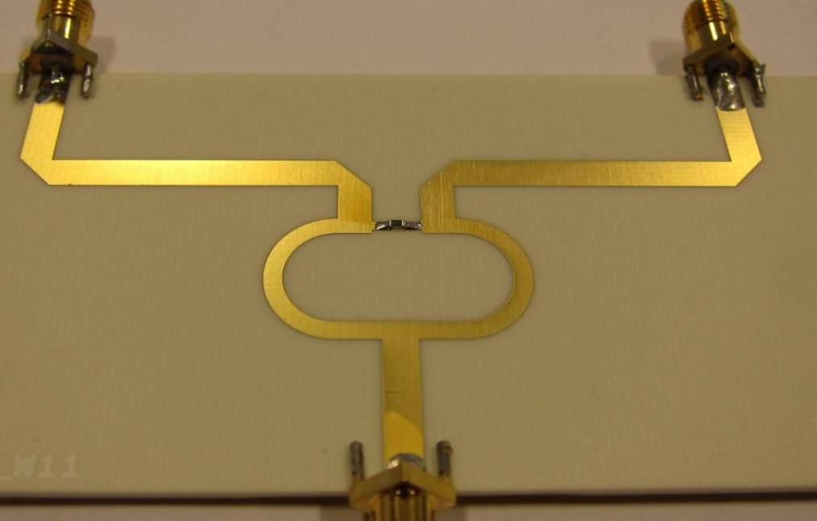
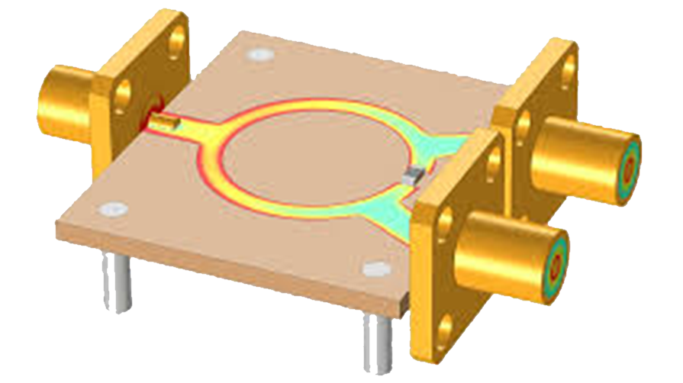
Wilkinson Power Divider

